Slide 1
Workshop 1A:
Introduction to continuous program improvement processes
Susan McCahan
Vice-Dean, Undergraduate
Faculty of Applied Science
University of Toronto
Peter Wolf
Director
Centre for Open Learning & Educational Support
University of Guelph
Brian Frank (project coordinator), Queen’s University
Susan McCahan, University of Toronto
Lata Narayanan, Concordia University
Nasser Saleh, Queen’s University
Nariman Sepehri, University of Manitoba
Peter Ostafichuck, University of British Columbia
K. Christopher Watts, Dalhousie University
Peter Wolf, University of Guelph
Notes:
Susan

Slide 2
Workshop Outcomes:
This introductory workshop presents an overview of continuous program improvement processes as required by CEAB to demonstrate that engineering program graduates possess twelve key attributes. It will place CEAB's graduate attributes in the context of other expectations by national and international organizations, and include topics such as creating a process for assessment, creating indicators, mapping attributes to the curriculum, assessing students, and using data to improve the program. It will include an overview of approaches taken by some Canadian engineering programs and describe available resources.
This workshop targets participants who are looking for an overview of graduate attribute assessment. This workshop will be similar to the EGAD workshops run at CEEA 2010 and 2011, and those conducted by request for engineering programs.
You should be able to
Describe a continuous curriculum improvement process
Utilize the elements of a continuous improvement process to
  Begin to develop an action plan
  Implement continuous improvement
Notes:
pw

Slide 3
Agenda
1 Program Evaluation: Getting Started
2 Mapping the Curriculum
5 Data-Informed Curriculum Improvement:
Setting Priorities and Planning for Change
3 Identifying and collecting
data on student learning
4 Analyzing and Interpreting the Data
Notes:
pw

Slide 4
Background
Accreditation bodies in most industrialized countries use outcomes-based assessment to demonstrate their students' capabilities.
Washington Accord: allows substantial equivalency of graduates from Australia, Canada, Hong Kong, Republic of Ireland, New Zealand, South Africa, United Kingdom, and United States, Japan, Singapore, Korea, and Chinese Taipei
Discussions by CEAB and National Council of Deans of Engineering and Applied Science (NCDEAS) led to graduate attribute expectations in 2008
Engineering Graduate Attribute Development (EGAD) project sponsored by NCDEAS formed by representatives from those schools, started Jan 2011
Notes:
sm

Slide 5
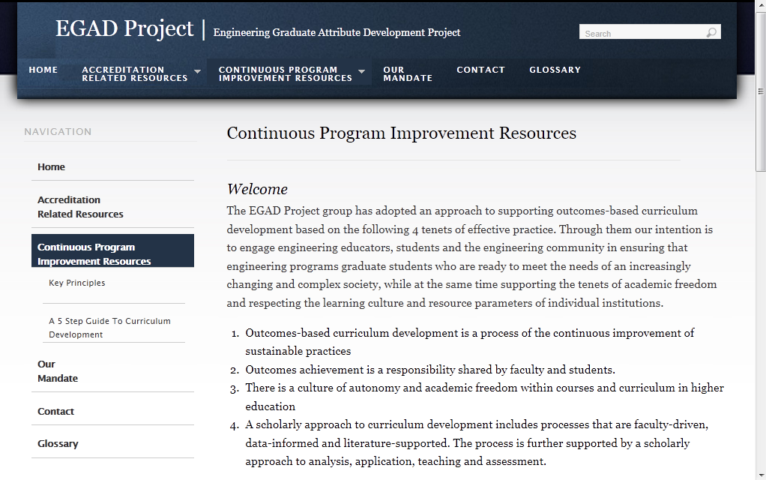
http://egad.engineering.queensu.ca/
Notes:
sm

Slide 6
Outcomes-based curriculum development is a process of the continuous improvement of sustainable practices
Outcomes achievement is a responsibility shared by faculty and students
There is a culture of autonomy and academic freedom within courses and curriculum in higher education
A scholarly approach to curriculum development includes processes that are faculty-driven, data-informed and literature-supported. The process is further supported by a scholarly approach to analysis, application, teaching and assessment.
Notes:
sm

Slide 7
Grad attributes process is analogous to a research project on your curriculum.
Develop research questions:
  What do you want to know about your students’ learning?
What methods will you use to investigate these questions?
How will the data inform you?
How will you make use of the information?

Slide 8
Curriculum Assessment Process
Data-informed curriculum improvement:
Setting priorities and planning for change
1. Program
Evaluation:
Defining purpose
and indicators
Analyzing
and Interpreting
the data
Stakeholder input
3. Identifying and Collecting Data
2. Mapping
the Curriculum

Slide 9
Kirkpatrick’s Four Levels of Evaluation
360 degree data from various stakeholders, collected over time
  qualitative, empirical & quantitative data
  map the curriculum
  consider increasing levels of sophistication of attributes achievement through programme years, co- & extra-curricular
Use multiple indicators
Ensure administrative faculty & student engagement & related resources - analysis, interpretation & action
Key Question: Did the students achieve desired outcomes of the programme of study?
Timing: Usually done 3 months – 2 years after learning experience
Level 4 - Results
Key Question: Are the newly acquired skills, knowledge, or attitude being used by the learner after the learning event is completed?
Timing: Usually done 1 month – 3 months after learning
Level 3 – Behavior
Level 2 –
Learning
Key Question: Did the students achieve the desired learning objective(s)?
Timing: Usually done immediately or soon after learning
Key Question: What was the student reaction to the learning environment?
Timing: Usually done immediately or soon after the learning event(s)
Level 1 –
Reaction
Kirkpatrick, D. (1994). Evaluating Training Programs: The Four Levels. San Francisco: Berrett-Koehler

Slide 10
Sample Process Framework
CEAB Attributes
SoE Attributes
Define attributes, establish thresholds and targets and determine indicators
Faculty Workshops / Retreats
Articulate where attributes will be fostered and/or embedded in the curriculum (cumulative experience in 4th year capstone design course)
Faculty Retreats / Curriculum Committee
Course Progression Maps
Attribute Maps
Feedback on achievement of Attributes
Curriculum Assessment (faculty, alumni, employers, students, etc.): SWOT
Curriculum Development Plan
CEAB Accreditation Report
Notes:
faculty feedback – buy in

Slide 11
1 Program Evaluation: Getting Started
2 Mapping the Curriculum
5 Data-Informed Curriculum Improvement:
Setting Priorities and Planning for Change
3 Identifying and collecting
data on student learning
4 Analyzing and Interpreting the Data
Notes:
pw

Slide 12
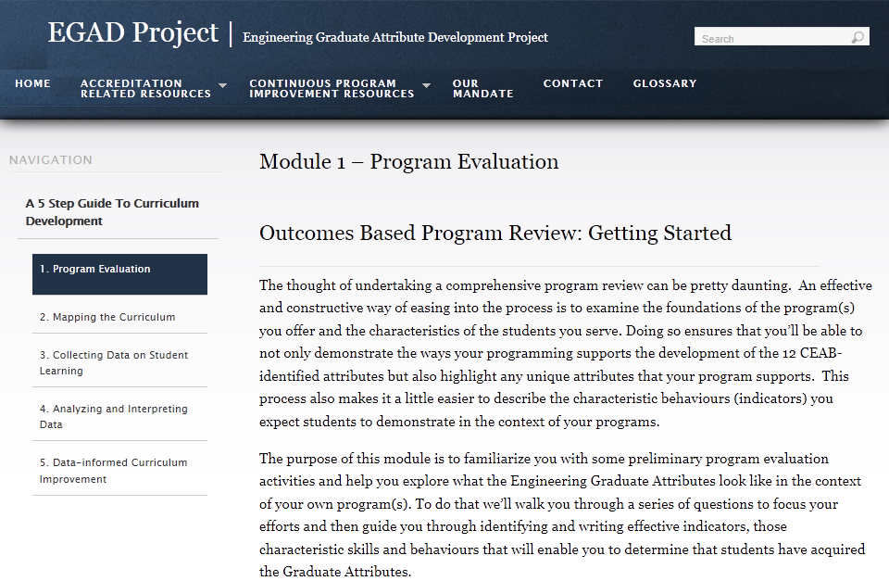
http://egad.engineering.queensu.ca/

Slide 13
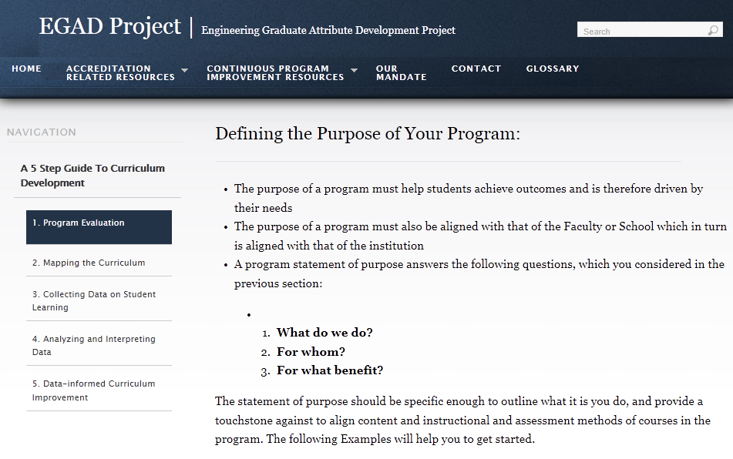
http://egad.engineering.queensu.ca/

Slide 14
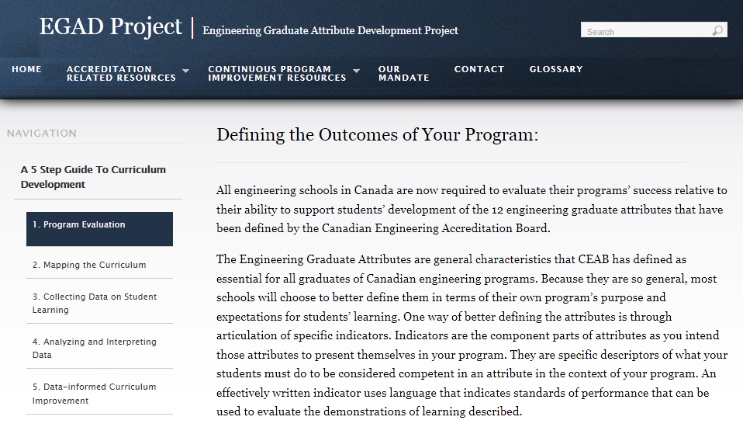
http://egad.engineering.queensu.ca/

Slide 15
What Are Indicators?
Descriptors of what students must do to be considered competent
in an attribute; the measurable & pre-determined standards
used to evaluate curriculum
Lifelong learning
An ability to identify and address their own educational needs in a changing
world in ways sufficient to maintain their competence and to allow them to
contribute to the advancement of knowledge
Can this be directly
measured?
Would multiple
assessors be consistent?
Would assessments
be meaningful?
Probably not, so more specific measurable indicators are needed.
This allows the program to decide what is important

Slide 16
Indicators
Lifelong learning
An ability to identify and address their own educational needs in a changing
world in ways sufficient to maintain their competence and to allow them to
contribute to the advancement of knowledge
Graduate
attribute
The student:
Critically evaluates information
for authority, currency &
objectivity when referencing
literature
Identifies gaps in knowledge and
develops a plan to address
Indicators
Describes the types of
literature of their field
& how it is produced
Uses information ethically &
legally to accomplish
a specific purpose
Notes:
I changed performance indicators to Indicators
BTW one of the critical indicators of a student’s ability to engage in Lifelong Learning is their ability to identify gaps in their knowledge and skill sets and create a plan to address them

Slide 17
Sample Indicators
Investigation:
An ability to conduct investigations of complex problems by methods that include appropriate experiments, analysis and interpretation of data, and synthesis of information in order to reach valid conclusions
Global Outcomes | Indicators
Demonstrate the ability to define a problem | Lower level Describe how to define a problem for purposes of investigation Explain how to find previous work Graduating level State the problem, its scope and importance Describe the previous work State the objective of the work
Demonstrate the ability to devise and execute a plan to solve a problem | Lower level Describe standard tests (experiments) and methods for information collection Graduating level Select a set of tests to be conducted Select, plan and apply the methods for collecting the information Identify limitations of the tests and methods used and their impact on the results.
Demonstrate the ability to use critical analysis to reach valid conclusions supported by the results of the plan | Analyze the results Formulate the conclusions Validate conclusions by induction or deduction Compare conclusions with previous work Characterize the limitations and implications of the conclusions

Slide 18
Taxonomies
Taxonomy: a classification of learning objectives
Used to categorize the type and depth of learning
Helpful (necessary?) for writing meaningful indicators
Helpful for writing effective assignments and exams
Many examples available
  EGAD website
  EC2000, ABET 2009
  UK-SPEC, Engineering Subject Centre Guide
  Engineers Australia
  CDIO Syllabus
  . . .
Notes:
Peter

Slide 19
Instructional Alignment
Course - agreement between objectives, activities & assessments
Curriculum - the degree to which the student experience builds upon previously developed attributes
Indicators /
Outcomes
Based on: Tyler, R. (1949) Basic principles of curriculum and instruction (University of Chicago Press, Chicago).
Learning
Activities
Learning
Assessments

Slide 20
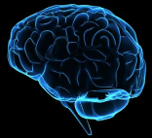
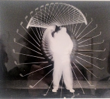

Domains of Learning
(Bloom, B. S., Engelhart, M. D., Furst, E. J., Hill, W. H., & Krathwohl, D. R. (1956). Taxonomy of educational objectives: the classification of educational goals; Handbook I: Cognitive Domain New York, Longmans, Green, 1956. )
Cognitive / Knowledge
Affective / Habits of Mind
Psychomotor / Physical Skills

Slide 21
Creating
Evaluating
Understanding
Applying
Analyzing
Remembering
Cognitive Domain
knowledge & development of intellectual skills
.
Anderson, L. & Krathwohl, D. A. (2001) Taxonomy for Learning, Teaching and Assessing: A Revision of Bloom's Taxonomy of Educational Objectives New York: Longman

Slide 22
Organization
Adaptation
Set
Guided Response
Mechanism
Perception
Psychomotor Domain
physical movement, coordination & use of motor skills
Simpson, E.J. (1972) The Classification of Educational Objectives in the Psychomotor Domain Washington DC: Gryphon House

Slide 23
Characterize by Value
Organize & Conceptualize
Receive
Respond
Value
Affective Domain
Emotions-based, including values, motivations, attitudes & habits of mind
Krathwohl, D. R., Bloom, B. S., & Masia, B. B. (1973). Taxonomy of Educational Objectives, the Classification of Educational Goals. Handbook II: Affective Domain. New York: David McKay Co., Inc.

Slide 24
Domains of Learning
(Bloom, B. S., Engelhart, M. D., Furst, E. J., Hill, W. H., & Krathwohl, D. R. (1956). Taxonomy of educational objectives: the classification of educational goals; Handbook I: Cognitive Domain New York, Longmans, Green, 1956. )
Knowledge
Habits of Mind
Physical Skills
Curriculum ‘Sweet Spot’

Slide 25
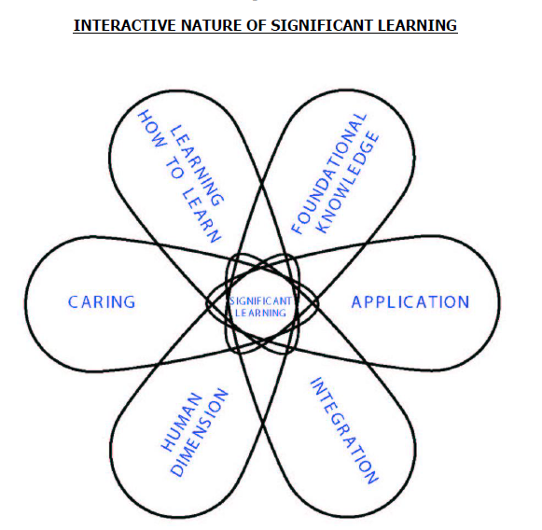
Developing Indicators
Interactive Nature of Significant Learning
Structure of Observed Learning Outcome (SOLO)
describes levels of increasing complexity in student's understanding of subjects
Pre-structural
Uni-structural
Multi-structural
Relational
Extended abstract
Proposed by: John B. Biggs &K. Collis.
Atherton, J. S. (2005) Learning and Teaching: SOLO taxonomy
From “A Self-Directed Guide to Designing Courses for Significant Learning” L. Dee Fink, PhD. http://www.deefinkandassociates.com/GuidetoCourseDesignAug05.pdf
Notes:
Taxonomy: a classification of learning objectives
Used to categorize the type and depth of learning
Helpful (necessary?) for writing meaningful indicators
Helpful for writing effective assignments and exams
Many examples available
EGAD website
EC2000, ABET 2009
UK-SPEC, Engineering Subject Centre Guide
Engineers Australia
CDIO Syllabus

Slide 26
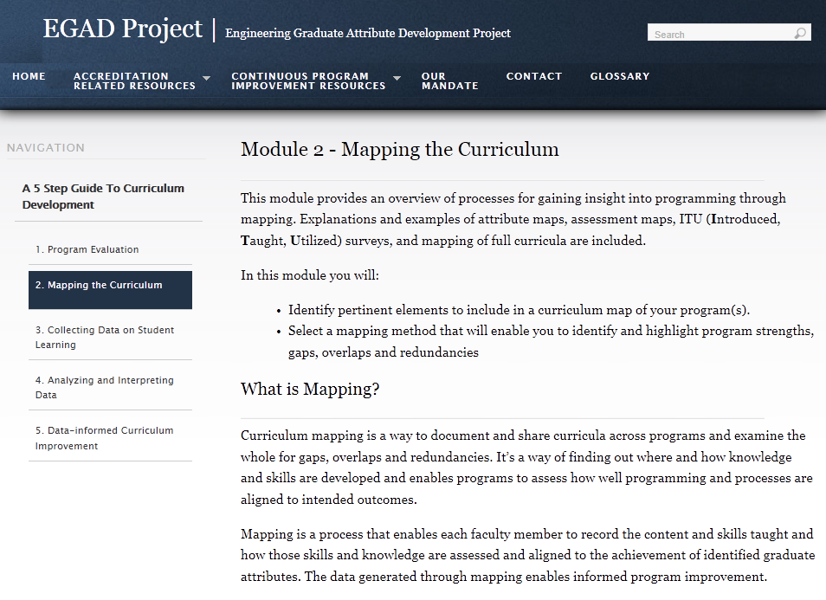
http://egad.engineering.queensu.ca/

Slide 27
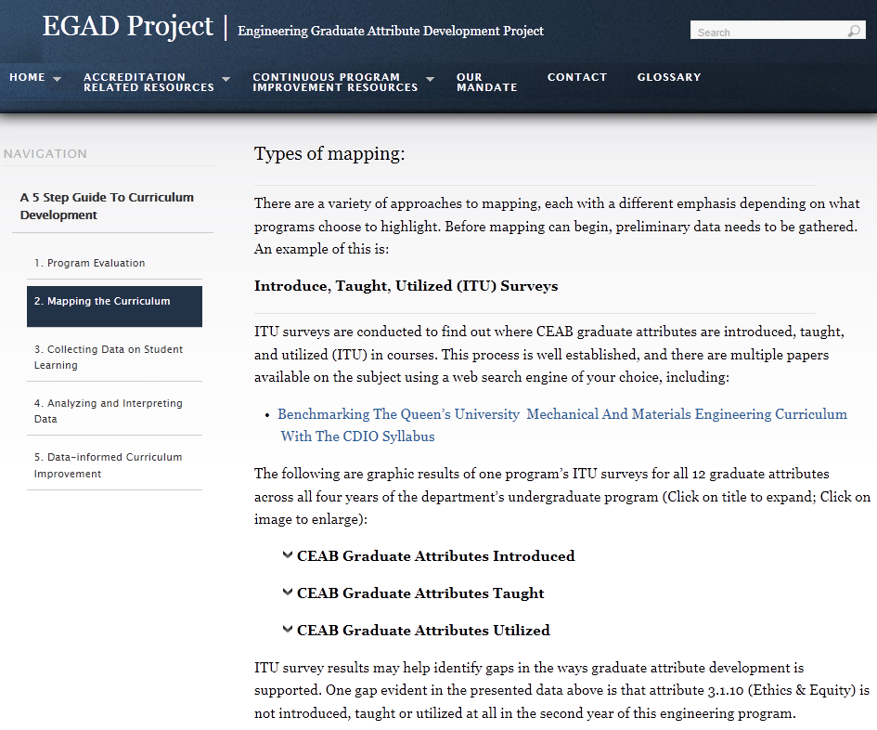

Slide 28
One method of many

Slide 29
Curriculum Mapping
Course
Progression
Graduate
Attributes
courses
thru
curriculum
match outcomes
to courses that
foster them

Slide 30
Course Progression Maps
Purpose:
to create a visual representation of student progress through curricula
to explore curriculum flow, coherence, and the balance of required and elective courses for the entirety of the degree program
Data collected from:
Calendars
Course outlines
Curriculum committees
PSYC 100
PSYC 200
PSYC 300
Notes:
Mary

Slide 31
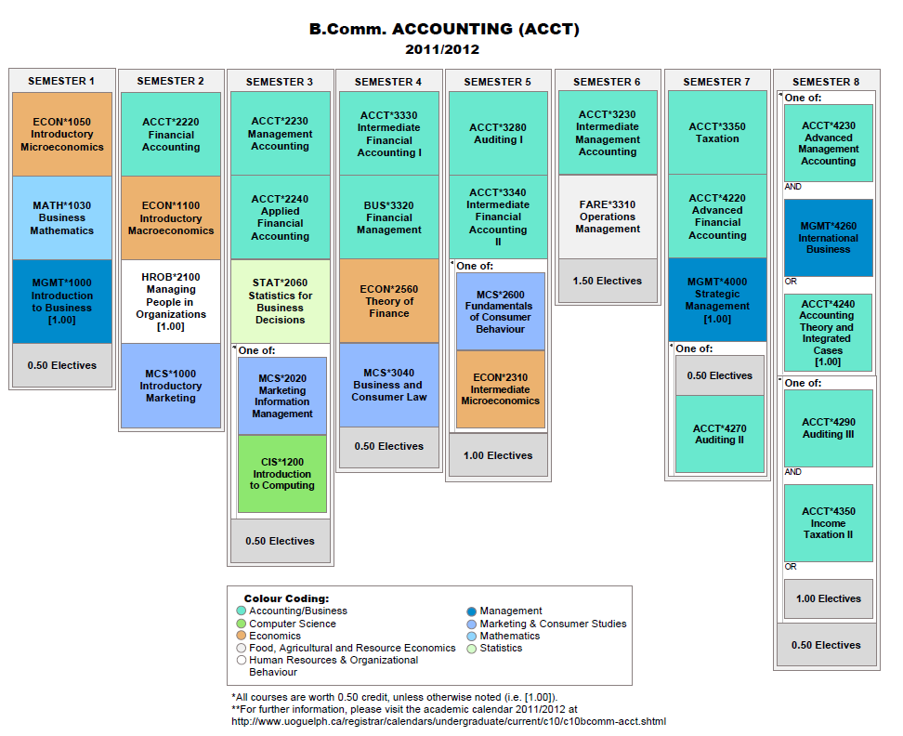
http://vue.tufts.edu

Slide 32
Programme Attributes Map
Goal: To match programme outcomes with individual courses that intentionally foster the development of selected outcomes.
Data collected from:
Faculty
Course outlines
Curriculum committees

Slide 33
Collaborative Mapping Process
Instructor Input
Colleague Review
Implement Action Plan
Evaluate Results
Develop Action Plan
Analysis & Interpretation
Especially useful for those whose courses serve as co-or pre-requisites
Identify patterns, gaps, overlaps & redundancies
Use SWOT (or other) to explore attribute development; instructional and assessment strengths/misalignments; skill integration etc.
Outline a timetable for implementing change and establish a committee and roles to implement the plan
Enhance curriculum alignment so that materials, instruction and assessment further support the intended learning
Seek opportunities to integrate & cluster attribute development
Add/remove or adaprt resources, learning activities & assessment
http://egad.engineering.queensu.ca/?page_id=28#maincontent

Slide 34
Course Survey:
Instructional methods used
Assessment approaches for students
Which graduate attribute, if any, is intentionally fostered in this course? At what level of sophistication?
How is each attribute taught and/or assessed?
How are the marks distributed over the semester?

Slide 35
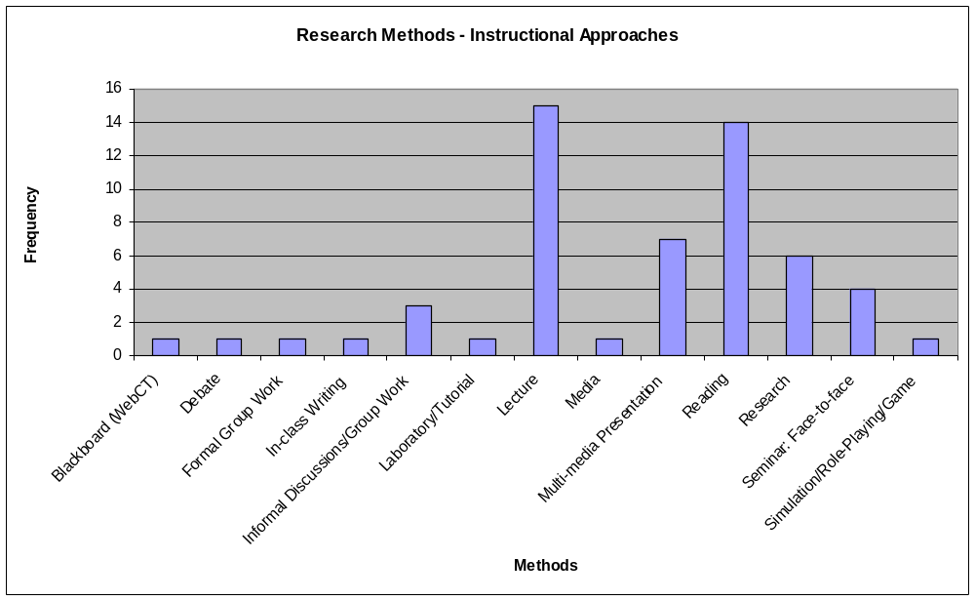
Outcome: Research Methods –

Slide 36
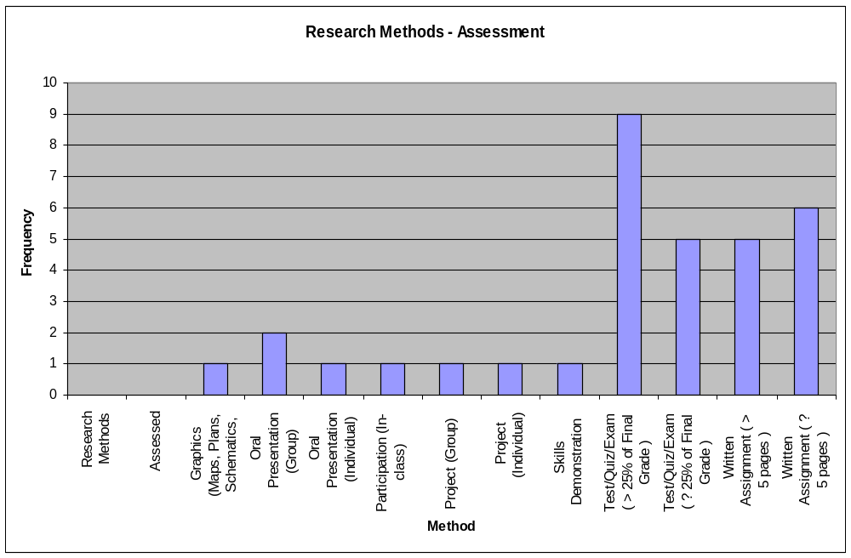
Outcome: Research Methods

Slide 37
Outcomes Development

Slide 38
Graduate Attributes Assessment
It is the program being assessed, not the students
  Part of a continual improvement process
Not required to assess every student
  Graduate Attributes is not a “minimum path” assessment
  Not required to track individual students
  Can use sampling to gather representative data
Not required to assess in every course
Not required to assess every year

Slide 39
Curriculum Mapping
Issues & Challenges
Discussion
What are the issues challenges you have faced, think you will face, when mapping attributes to courses?

Slide 40
Curriculum Mapping: Issues & Challenges
Attributes are unclear, need further definition, and/or there is little group agreement on attribute definition, threshold, target, indicators, etc
Faculty feel ‘controlled’ and inhibited from altering courses and assignments
Collecting mapping data from courses not within the department
Misalignment within sections of the same course
‘Orphan’ courses may suggest
Vocal faculty dominate process/not full participation/not inclusive of TAs &other instructors
Data collection-related:
  If using a survey approach…
    Low faculty survey completion rate fill out the survey
  If using course outlines
    not accurate

Slide 41
Recommended Practices
Data-informed
Faculty-driven
Student-engaged
Stakeholder-informed
Culture- & context-specific
Rigorous & authentic
Continuous improvement
of sustainable practices
Resourced & recognized
Externally facilitated
Continuous improvement is at least as important as ‘reporting’
Refine the blend of people, processes & resources
  Transition requires investment
  Keeping momentum
Mistakes will happen
Keep in Mind…
Notes:
PW
Rigorous - Link to scholarship and external resources and research
Resourced - Opportunity for group analysis and reflection, p&t, time…NEW WORK!

Slide 42
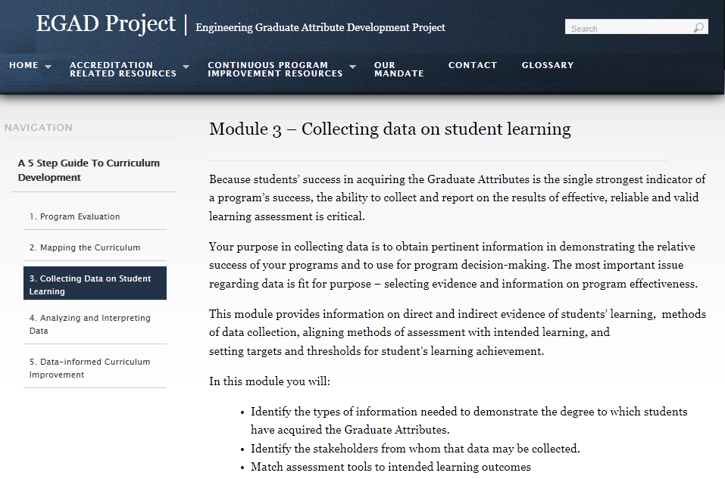
http://egad.engineering.queensu.ca/

Slide 43
Assessment Plan
Results
Behavior
Learning
Reaction
Evaluation Method | Stakeholders | Frequency | Questions /Issues Explored
Exit focus group - Lunch | Graduating Students | Annual | Describe your most valuable learning experiences? Comments on other aspects of your Guelph experience: Awards? Student clubs? Academic support?
 |  |  | Describe your most important/least important learning experiences at Guelph? What would you drop from the curriculum? What would you add to the curriculum? What advice would you have for a new student?
Student feedback | Course Feedback Forms | Bi-Annual | Use of standard undergraduate feedback forms
Student grades & Sample work | Course Feedback Forms | Bi-Annual | Is grading across courses consistent in highlighting the successful and unsuccessful students? Are there trends in grades by outcomes, topic, level of sophistication, etc.?
Focus group lunch | Employers | Tri-Annual | Describe in what ways the content and objectives of the program match or do not match your expectations graduates? What do you look for when hiring?
 |  |  | Based on your experience with graduates employed in your company, how well do our graduates meet your expectations? Describe one or more ways in which our program has enhanced our graduates ability to help your organization fulfill its mission or meet its objectives Please suggest one or more changes to help us improve the program. What can we do to better prepare our graduates for employment? What advice would you give to a recent or soon to be graduate?
Mapping | Course Outlines | Tri-Annual
Previous reports & reviews | Professional association | Tri-Annual
Retreat | Faculty/Grad Students | Annual | Review of data collected and development of action plan
Handbook for Curriculum Assessment – dowload at http://www.tss.uoguelph.ca/resources/pdfs/HbonCurriculumAssmt.pdf
Course by course & cross curricular learning outcomes
Portfolio will be used as the principal assessment tool – prepare in 4th semester & update resubmit in last semester

Slide 44
Triangulation
Include opportunities for informal assessment, students’ self-reports of learning, and even unsolicited data from placement supervisors or employers
Use more than one type of assessment when analyzing data
Value all assessment not just major events
Use the data gained from assessment to answer questions about authentic learning
Look at data across time intervals

Slide 45
Assessment Tools
How to measure learning against specific expectations?
Direct measures – directly observable or measurable assessments of student learning
  E.g. Student exams, reports, oral examinations, portfolios, concept inventories etc.
Indirect measures – opinion or self-reports of student learning or educational experiences
  E.g. grades, surveys, focus group data, graduation rates, reputation, etc.

Slide 46
Why not use grades to assess outcomes?
How well does the program prepare
students to solve open-ended
problems?
Student transcript
Electric Circuits I Electromagnetics I Signals and Systems I Electronics I Electrical Engineering Laboratory Engineering Communications Engineering Economics ... Electrical Design Capstone | 78 56 82 71 86 76 88 86
Are students prepared to continue
learning independently after
graduation?
Do students consider the social
and environmental implications of
their work?
Course grades usually aggregate
assessment of multiple objectives,
and are indirect evidence for
some expectations
What can students do with
knowledge (plug-and-chug vs.
evaluate)?

Slide 47
Selecting Assessments
Looking for assessments that are:
  Valid: they measure what they are supposed to measure
  Reliable: the results are consistent; the measurements are the same when repeated with the same subjects under the same conditions
Capitalize on what you are already doing
Look for “leading indicators”
One approach (not the only!) is with Rubrics

Slide 48
Rubrics
Dimensions (Indicator) | Scale (Level of Mastery)
 | Not demonstrated | Marginal | Meets expectations | Exceeds expectations
Indicator 1
Descriptor 1a
Descriptor 1b
Descriptor 1c
Descriptor 1d
Indicator 2
Descriptor 2a
Descriptor 2b
Descriptor 2c
Descriptor 2d
Indicator 3
Descriptor 3a
Descriptor 3b
Descriptor 3c
Descriptor 3d
Reduces variations between grades (increase reliability)
Describes clear expectations for both instructor and students (increase validity)

Slide 49
Selecting Assessments
Reminders:
  Capitalize on what you are already doing
  Do not try to assess in every course
Rubrics can help to increase reliability and validity
Another approach: embedded questions
  Set tests, exams, quizzes, etc. such that specific questions are linked to specific indicators
  Record marks separately by question

Slide 50
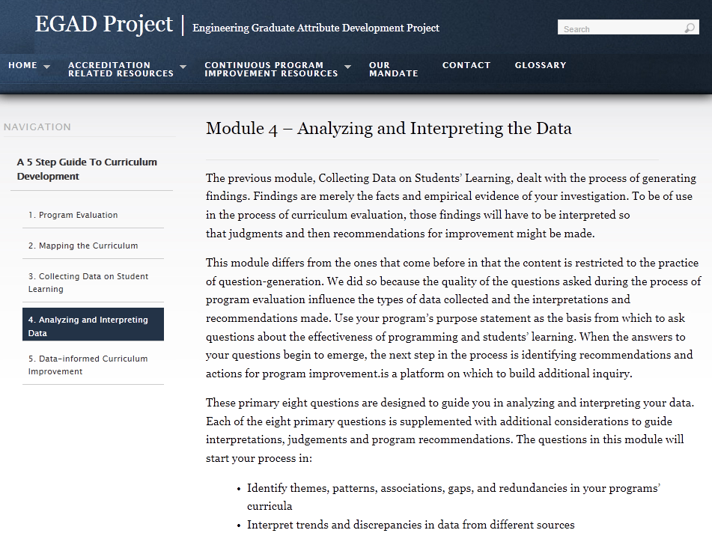
http://egad.engineering.queensu.ca/

Slide 51
On which Graduate Attributes is programming focused?
Where are the focus attributes being best supported?
Which Graduate Attributes are reported as getting the least attention?
What program-specific attributes are supported by your curriculum?
(i.e. attributes not identified by CEAB)
What gaps exist in the program?
How are your students doing?
Where in the program is student development being best supported?
In what areas are students doing less well?

Slide 52
Check reliability and validity of data
Critically think through the analysis
Refer back to research questions

Slide 53
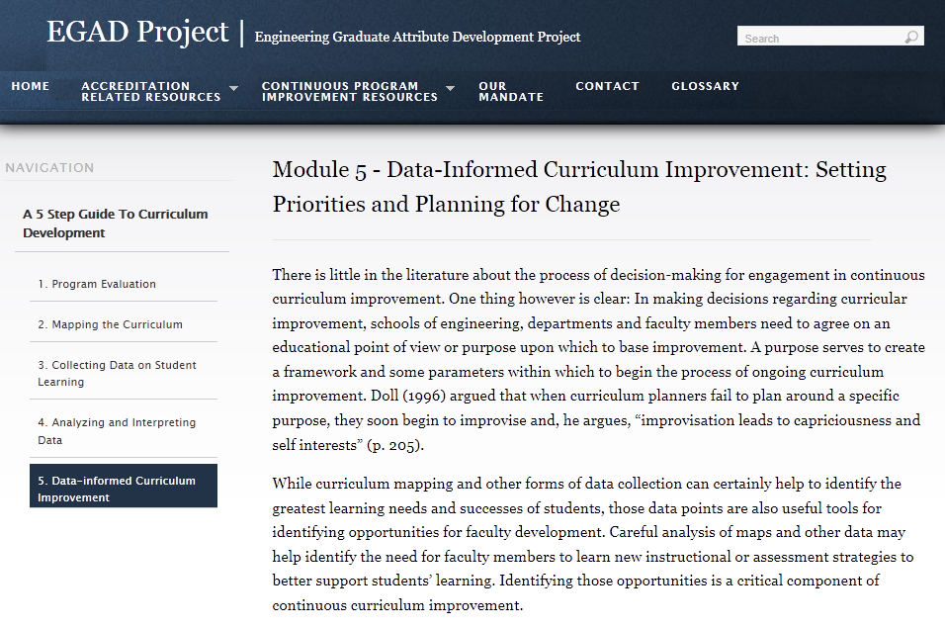
In this module, a series of fictitious, though realistic scenarios are outlined. Findings from a variety of data sources are presented for each scenario and indications, judgments and recommendations that might result are discussed. The approach to curriculum change adopted in each scenario outlines the ways in which a series of relatively minor changes adopted by many can result in dramatic improvements to programming, curricular alignment and overall student learning achievement and satisfaction.

Slide 54
Also, not enough information to inform curriculum change
80% of our students meet or exceed expectations for this attribute
80%
Investigation

Slide 55
How many indicators are enough?
80%
Indicator #1
Indicator #2
Indicator #3
Investigation
Not clear
Gloria Rogers suggests 3-5

