Slide 1

Graduate attribute assessment as a
COURSE INSTRUCTOR
Brian Frank and Jake Kaupp
CEEA Workshop W2-1B
http://bit.ly/KK6Rsc
Notes:
Resources: Heywood, Assessment in Higher Ed.
Rubrics book
Program evaluation book
Possible content:
Develop scoring rubrics to assist in evaluating abstract learning outcomes.
Understand the pros and cons of various data collection methods.
Utilize a planning matrix.
Create clear and concise reports on assessment processes and results.
Understand the difference between assessing program educational objectives and student learning outcomes.
Understand the challenge of engaging faculty.
Here is a brief outline of the day:
Introduction and review of key terminology
Introduction to the assessment plan cycle as it relates to continuous quality improvement
Developing measurable performance criteria
Writing scoring rubrics
Simplifying curriculum mapping
Reviewing and selecting data collection tools
Developing efficient, sustainable processes
Reviewing a planning matrix
Reporting results
Identifying faculty resistance
If you've already developed your program's objectives and outcomes, and you're looking to take the next steps in your assessment plan, this workshop is for you.

Slide 2
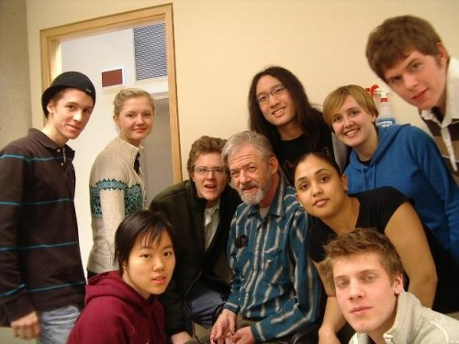
Why?
Notes:
Around 2005 I inherited coordination of our first year design course – around 700 students in our common first year program. Spent a lot of time working to continue developing what was an innovative course, which we knew was a useful experience but for which we had little hard data to use.
In 2008 I became director of program development, and Dean told me to figure out graduate attribute assessment. It turns out that formalizing processes for graduate attribute assessment helped with the first problem.
Why are we doing this? We have to!!!
But... also:
Eases curricular design
Creates structure for regular improvement
Improve quality of the environment for students
why it can be useful for the instructor: Course planning improves learning and reduces issues later

Slide 3
CEAB program improvement processes
Course instructor
Develop sustainable process to evaluate performance against expectations
Facilitate a long-term collaboration with colleagues
Notes:
Objectives:
Be able to connect program’s graduate attribute assessment process to course activities - both directions.
Create a sustainable process within a course to improve learning in the program
Facilitate a collaboration with across the country doing the same thing. For that reason we’re proposing to use technology that will allow continued collaboration.
Much of this workshop will be working time to setup collaboration.
Give everyone login for response system (TopHat, Catalytics, etc.)
Point out website with references and resources (course planning matrix, rubric, assessment measures, etc.), and material in Google Drive
Give link to poll asking people what kind of course experience they would like to work on, then we can decide how to group people.

Slide 4

CEAB requirements include:
indicators that describe specific abilities expected of students
A mapping of where attributes are developed and assessed within the program
Description of assessment tools used to measure student performance (reports, exams, oral presentations, …)
Evaluation of measured student performance relative to program expectations
a description of the program improvement resulting from process

Slide 5

Graduate attributes required
Knowledge base for engineering
Problem analysis
Investigation
Design
Use of engineering tools
Individual and team work
Communication skills
Professionalism
Impact on society and environment
Ethics and equity
Economics and project manage.
Lifelong learning
Notes:
Engineering specific – address complex problem solving, design, communications - critical skills for innovation.

Slide 6
1
2
Program objectives and indicators
Mapping the curriculum
What do you want to know about the program?
Course
involvement
Curriculum & process improvement
Analyze and interpret
Collecting data
5
4
3
Notes:
General process informed by what do you want to know that is particular to your program – do you have a special stream you want to know more about? Do you have long-standing issues? Have you had concerns about a specific attribute?
Course instructor involvement: map indicators to course, assesssment

Slide 7
Course
Learning & teaching
activities
Learning
outcomes
Assessment
to meet outcomes
to assess outcomes
John Biggs (1999): What the Student Does: teaching for enhanced learning, Higher Education Research & Development, 18:1, 57-75
Notes:
Within a course we can consider three fundamental concepts that will impact connecting courses to the overall process.
We’re going to start by using a process to connect learning outcomes in a course (goals and curriculum) with your educational approach (the things you get students to do), and assessment with program-wide processes.

Slide 8
Program’s special features and questions
Program’s indicators
Program’s data
Course
Learning & teaching
activities
Learning
outcomes
Assessment
to meet outcomes
to assess outcomes
Notes:
A course’s activities tie into program’s plan by ensuring that courses align with the attributes and indicators, and ensuring that data on student performance goes back to the program for program improvement.

Slide 9
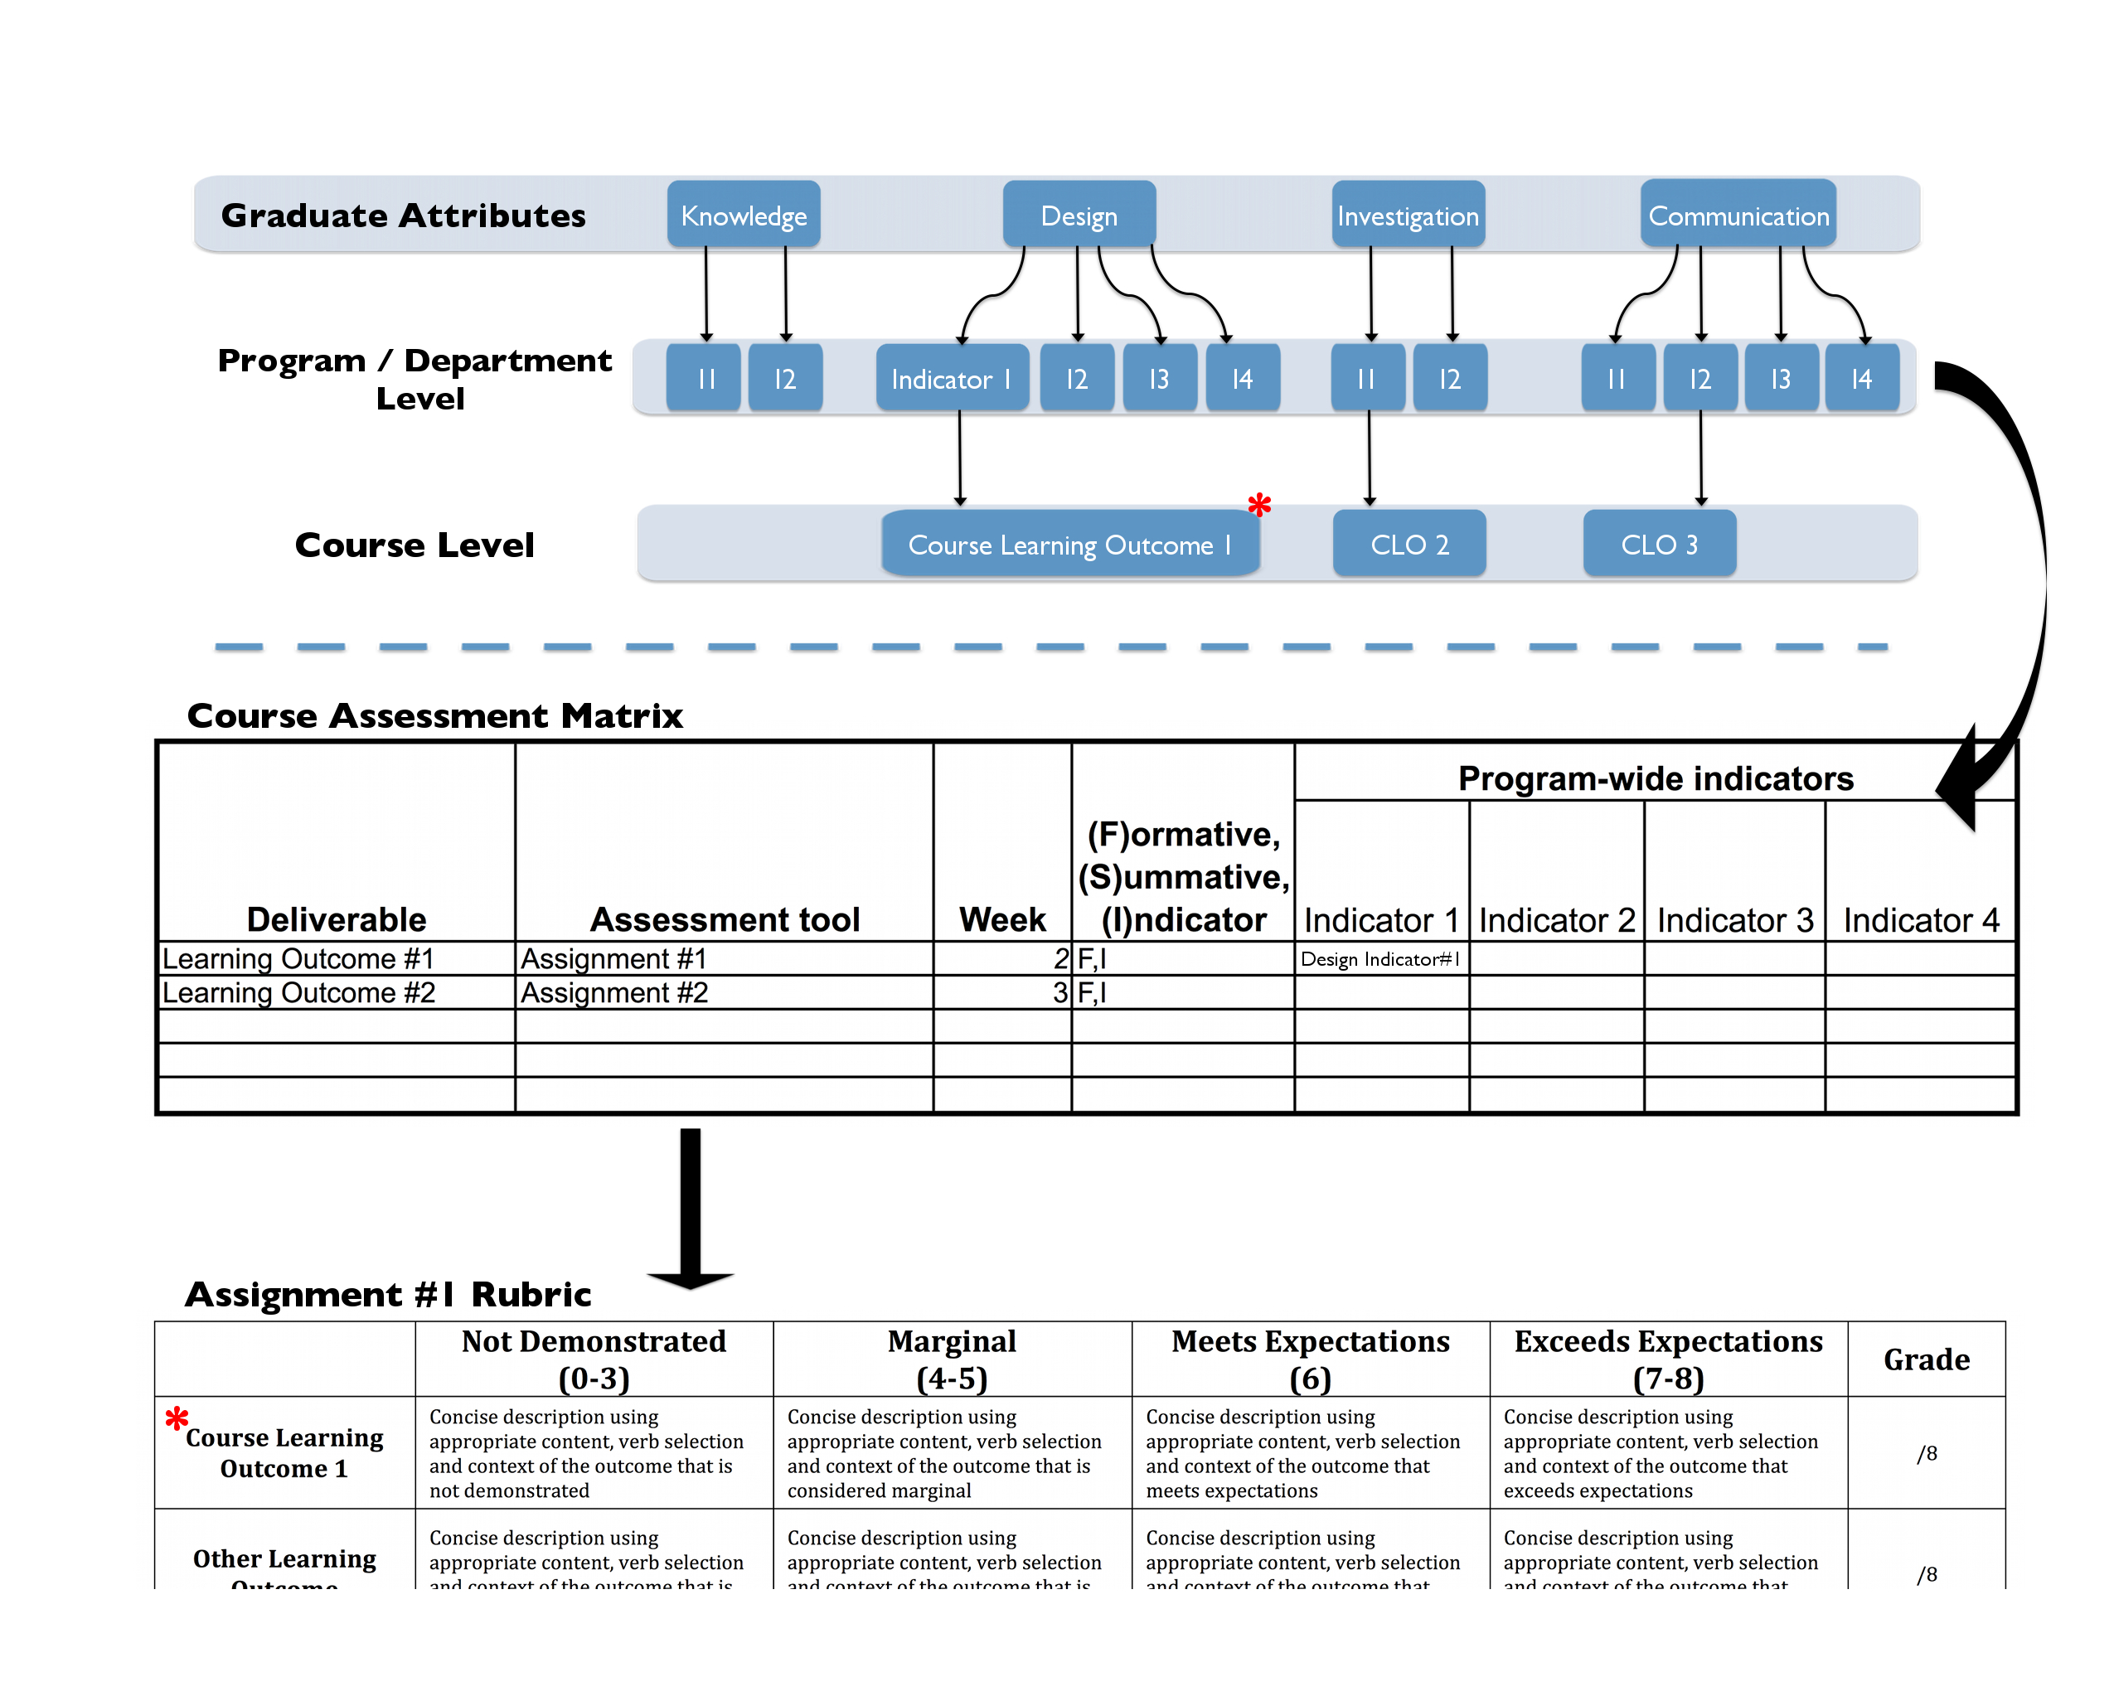
Notes:
To alleviate some confusion between indicators and learning/course outcomes and their use in assessment.
A learning outcome or course learning outcome can be developed and used to denote the intended learning outcome of a particular student activity. The course learning outcome is linked/aligned to a indicator for a specific attribute (in this case design). Using course learning outcomes in this manner allows for the instructor to accurately describe the intended outcome using specific detail and language best suiting the activity, rather than using the global indicator that may be ill-suited as an learning outcome.
Learning outcomes offer a measure of flexibility for instructors, allowing them to develop outcomes that suit the activity as well graduate attribute assessment.
Ultimately, the use of learning outcomes is entirely arbitrary, as program/departmental indicators may be well-crafted and suitable for assessment.

Slide 10
WHAT WORKS to improve learning?
800 meta-analyses
50,000+ studies
250+ million students
Hattie, J. (2009). The Black Box of Tertiary Assessment: An Impending Revolution. In L. H.
Meyer, S. Davidson, H. Anderson, R. Fletcher, P.M. Johnston, & M. Rees (Eds.), Tertiary Assessment & Higher Education Student Outcomes: Policy, Practice & Research (pp.259-275). Wellington, New Zealand: Ako Aotearoa
Notes:
Questions often arise: what impact can all of this have? Is it worth the effort?
The largest study I’m aware of on the factors that impact learning using students from kindergarten to university

Slide 11
When teachers claim that they are having a positive effect on achievement or when a policy improves achievement this is almost a trivial claim: virtually everything works. One only needs a pulse and we can improve achievement.
J. Hattie, 2009
“
”
Hattie, J. (2009). The Black Box of Tertiary Assessment: An Impending Revolution. In L. H.
Meyer, S. Davidson, H. Anderson, R. Fletcher, P.M. Johnston, & M. Rees (Eds.), Tertiary Assessment & Higher Education Student Outcomes: Policy, Practice & Research (pp.259-275). Wellington, New Zealand: Ako Aotearoa

Slide 12
Notes:
What has the greatest effect on student performance?

Slide 13

Mapping indicators to a course

Slide 14
Program’s indicators
Course outcomes
OR
Program’s indicators
Course outcomes
Notes:
Course learning outcomes, if available, can set program indicators.
Or indicators can be tied to courses and used to develop course learning outcomes.

Slide 15
Assume: Indicators mapped to courses
Attribute | Indicator | Code | (D)evelop/ (A)ssess | Course
Knowledge base | Create mathematical descriptions or expressions to model a real-world problem | 3.01-FY1 | D,A | APSC-171
Knowledge base | Select and describe appropriate tools to solve mathematical problems that arise from modeling a real-world problem | 3.01-FY2 | D,A | APSC-171
Knowledge base | Use solution to mathematical problems to inform the real-world problem that gave rise to it. | 3.01-FY3 | D,A | APSC-171
Problem analysis | Identifies known and unknown information, uncertainties, and biases when presented a complex ill-structured problem | 3.02-FY1 | D,A | APSC-100
Problem analysis | Creates process for solving problem including justified approximations and assumptions | 3.02-FY2 | D,A | APSC-100

Slide 16
Indicators in your course
Applies prescribed process for solving complex problems (3.02-FY1)
Selects and applies appropriate quantitative model and analysis to solve problems (3.02-FY2)
Evaluates validity of results and model to describe limitations and quantify error (3.02-FY3)
Composes structured document following prescribed format using standard grammar and mechanics (3.07-FY1)
Analyzes quantitative data to reach supported conclusion with explicit uncertainty (3.03-FY1)

Slide 17
develop and assess indicators to answer questions.

Slide 18
Program’s indicators
Program’s data
Learning & teaching
activities
Learning
outcomes
Assessment
to meet outcomes
to assess outcomes
Tool: Course planning matrix
Notes:
A course’s activities tie into program’s plan by ensuring that courses align with the attributes and indicators, and ensuring that data on student performance goes back to the program for program improvement.

Slide 19
APSC-100: Engineering Practice I || 2012-2013
Course learning outcomes
Applies prescribed process for solving complex problems (3.02-FY1) Selects and applies appropriate quantitative model and analysis to solve problems (3.02-FY2) Evaluates validity of results and model to describe limitations and quantify error (3.02-FY3) Composes structured document using standard grammar and mechanics (3.07-FY1) Analyzes quantitative data to reach supported conclusion with explicit uncertainty (3.03-FY1)
Week | Learning objectives | Instructional approach and content | Learning activity | Assessment
1 | 4,5 | Lecture: motivation, course overview, models. | Lecture: Group activity to consider model for elevator failure problem | CLA/Cornell Critical thinking pretest (CLO7)
2 | 1,2,3,8 | Pre-studio: MATLAB online module 1 Lecture: complex problem solving, risk, hazard analysis | Lecture: Group activity to develop process for resolving elevator failure problem Pre-studio: MATLAB online readiness quiz (no grades) | MATLAB quiz #1 OHS online test (CLO6)
3 | 8,9 | Pre-studio: MATLAB online module 2 Lecture: argumentation, brainstorming | Lecture: analyze past assignments for effective argument MATLAB Studio: Importing data (problem #2) | MATLAB quiz #2
Notes:
Mapping between program wide indicators (codes), learning outcomes in the course (#s), instructional approach, activity, and assessment

Slide 20

Assessment measures
&
Teaching and learning activities
Notes:
The peer instruction and conceptual questions focus on conceptual understanding of physical systems. These approaches can be extended to complex problems: uncertain or unknown information, may be contradictory, multiple goals, multiple solutions, etc.

Slide 21
Assessment measures
Local written exam
(e.g. question on final)
External examiner
(e.g. Reviewer on design projects)
Standardized written exam
(e.g. Force concept inventory)
Oral exam
(e.g. Design projects presentation)
Performance appraisal
(e.g. Lab skill assessment)
Oral interviews
Simulation
(e.g. Emergency simulation)
Surveys and questionnaires
Behavioural observation
(e.g. Team functioning)
Focus group
Portfolios
(student maintained material)
Archival records
(registrar's data, records, ...)

Slide 22
Teaching and learning activities
Design project
Online module
Lecture with embedded activities
Laboratory investigation
Problem-based learning
Experiential (service learning, co-op)
Computer simulation/animation
Reciprocal teaching

Slide 23
Breakout 1
Develop a course plan
http://bit.ly/KK6Rsc
This presentation and sample indicators:
http://bit.ly/LZi2wf
Notes:
Breakout 1 instructions sheet: instructions on one side, list of assessment measures, list teaching and learning activities
Files in Google Drive linked off of link:

Slide 24
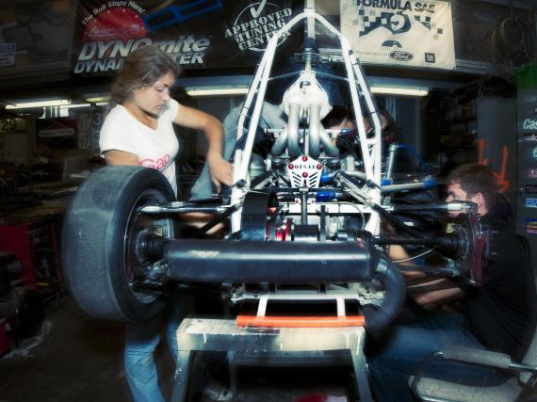
Scoring efficiently and reliably

Slide 25
Outcomes
assessment
Course grading
Notes:
If course grades are separate from outcomes and assessment for program improvement, it will be extra work for you and the graders, and course activities not necessarily developing the knowledge, skills, and behaviours to meet course outcomes.

Slide 26
Why not use grades to assess outcomes?
How well does the program prepare
students to solve open-ended
problems?
Student transcript
Electric Circuits I Electromagnetics I Signals and Systems I Electronics I Electrical Engineering Laboratory Engineering Communications Engineering Economics ... Electrical Design Capstone | 78 56 82 71 86 76 88 86
Are students prepared to continue
learning independently after
graduation?
Do students consider the social
and environmental implications of
their work?
Course grades aggregate
assessment of multiple objectives,
and provide little information for
program improvement
What can students do with
knowledge (recall vs.
evaluate)?

Slide 27
When assessing students, the scoring needs to be:
Valid: they measure what they are supposed to measure
Reliable: the results would be consistent when repeated with the same subjects under the same conditions (but with different graders)
Expectations are clear to students, colleagues, and external reviewers

Slide 28
Rubrics
Dimensions (Indicator) | Scale (Level of Mastery)
 | Not demonstrated | Marginal | Meets expectations | Exceeds expectations
Reduce variations between graders (increase reliability)
Describes clear expectations for both instructor and students (increase validity)

Slide 29
Threshold performance
Target performance
Dimensions (Indicator) | Scale (Level of Mastery)
 | Not demonstrated | Marginal | Meets expectations | Exceeds expectations
Indicator 1
Descriptor 1a
Descriptor 1b
Descriptor 1c
Descriptor 1d
Indicator 2
Descriptor 2a
Descriptor 2b
Descriptor 2c
Descriptor 2d
Indicator 3
Descriptor 3a
Descriptor 3b
Descriptor 3c
Descriptor 3d

Slide 30
ANALYTIC rubric for grading oral presentations (Assessing Academic Programs in Higher Education by Allen 2004)
 | Below expectation | Satisfactory | Exemplary | Score
Organization | No apparent organization. Evidence is not used to support assertions. | The presentation has a focus and provides some evidence that supports conclusions. | The presentation is carefully organized and provides convincing evidence to support conclusions
 | (0 – 2) | (3 – 5) | (6 – 8)
Content | The content is inaccurate or overly general. Listeners are unlikely to learn anything or may be misled. | The content is generally accurate, but incomplete. Listeners may learn some isolated facts, but they are unlikely to gain new insights about the topic. | The content is accurate and complete. Listeners are likely to gain new insights about the topic.
 | (0 – 2) | (5 – 7) | (10 – 13)
Style | The speaker appears anxious and uncomfortable, and reads notes, rather than speaks. Listeners are largely ignored. | The speaker is generally relaxed and comfortable, but too often relies on notes. Listeners are sometimes ignored or misunderstood. | The speaker is relaxed and comfortable, speaks without undue reliance on notes, and interacts effectively with listeners.
 | (0 – 2) | (3 – 6) | (7 – 9)

Slide 31
 | 0-3 (not demonstrated) | 4 (marginal) | 5-6 (meets expectations) | 7-8 (outstanding) | Mark (/8)
Purpose and style | Unclear purpose, very hard to understand. | Challenging to understand; tone and style inappropriate for the audience. | Clear purpose is met. Formal tone and style appropriate to audience | Professional tone and style. Authoritative and convincing | /8
Coherence and Format Sequence, transitions, formatting | Poorly organized; rambling, lacks unity; Inconsistent writing/formatting; many gaps or redundancies. | Organization sometimes unclear; significant gaps or redundancies, formatting problems; some wordy expressions, lacks transitions | Organized, appropriate sections, uniformly and correctly formatted; little irrelevant information. | Focused, logically organized; skillful and varied transitions. Professionally formatted. No irrelevant information | /8
Graphical communications | Figures and tables not related to text, don’t contribute to report; difficult to follow. | Some figures and tables not discussed in text; figure/table captions missing; incomplete list of tables/ figures. | Figures and tables referred to in text, captioned. Appropriate lists of figures/tables. | Figures and tables professionally formatted, integrated into text, complementing text | /8
Etc. | … | … | … | …

Slide 32
observable statements of performance are important
Notes:
Current approach: some threshold percentage on an assignment (50%, 60%, etc.). That may be made up of multiple attribute/indicators, and gives little useful data for improving the program. And if you know that one quarter of the students got less than that threshold on an assignment, what does that tell you that you can use to improve things? You typically have to look at individual questions, which focus on more specific things.
Example: taught microwave circuit design, and deliverables included design reports, exams, quizzes. For that group of students who didn’t do well, need to know specifically what objectives have lower success rates, and what issue the students had when they received a grade below threshold.
In the context of the PROGRAM, need the same thing – what things are we looking for, ensuring that multiple graders are consistent, and clear about expectations so the person down the hall can use the data for program improvement.

Slide 33
Breakout 2 create one deliverable and rubric for your course

Slide 34

… and Conference presentations
http://www.learningoutcomeassessment.org/Rubrics.htm#Samples
Notes:
APSC-100, UBC, Heywood, Nitko’s rubrics text, Biggs text
VALUE rubrics
Holistic and analytic rubrics

Slide 35
 |  | Below Expectations Major Errors or lack of Depth Unacceptable quality |  | Marginal Some significant errors or lack of depth Satisfactory quality | Meets Expectations Appropriate depth / few errors Good quality | Exemplary Exceptional depth / accuracy Outstanding quality
 |  | 0 | 1 | 2 | 3 | 4
(rows omitted)
Development and Analysis of Solution | Conceptualization: variety and quality of design solutions considered
 | Data: appropriate tools used to collect, analyze, and present data
 | Detailed Design: design decisions supported with appropriate justification
 | Predictions: appropriate tools used to predict performance of final device
(rows omitted)
Notes:
“Poor/good/great”, and 1-5 – problems with inter-rater reliability for large courses, and difficult to communicate areas needing improvement for communication with other courses/curriculum committee, grading not-transparent students

Slide 36
 |  | Level of Mastery
 |  | Below Expectations Major Errors or lack of Depth Unacceptable quality |  | Marginal Some significant errors or lack of depth Satisfactory quality | Meets Expectations Appropriate depth / few errors Good quality | Exemplary Exceptional depth / accuracy Outstanding quality
 |  | 0 | 1 | 2 | 3 | 4
Development and Analysis of Solution | Data: appropriate tools used to collect and analyze data | No physical prototyping is used in the project. | Physical prototyping tools are described but in very limited detail. There may be errors in the use of the tools. | Physical prototyping tools are described but only limited detail is included. | Appropriate tools for physical prototyping are selected and used correctly | Ideal tools for physical prototyping are selected and used correctly.
 | Detailed Design: design decisions supported with appropriate justification | There is no evidence of the application of engineering knowledge | There is little evidence of the application of engineering knowledge | There is some evidence of the application of engineering knowledge. | There is adequate evidence of the application of engineering knowledge | There is good evidence of the application of engineering knowledge
 | Performance Predictions: appropriate tools used to predict performance | Discrepancies between predictions and actual performance are not explained. | Discrepancies are mentioned, but reasons for the discrepancies are not explained or are incorrect. | Discrepancies in results are explained, but reasons for the discrepancies are incomplete | Discrepancies are explained. The accuracy and/or assumptions in the prediction are partially described. | Discrepancies are well justified. The accuracy and assumptions in the prediction approaches are explained and considered.
Notes:
Row 1: to specific
Row 2: “little”, “some”
Row 3: not aligned with appropriate tools

Slide 37
Outcome | Scale (Level of Mastery)
 | Not demonstrated | Marginal | Meets expectations | Exceeds expectations
3.01: Newtonian mechanics | remembers | understands | synthesizes | evaluates
3.02: Defines problem | remembers | analyzes | evaluates | creates
3. 03:Designs investigation | remembers | understands | analyzes | creates
Notes:
Setup using strict Bloom verbs – not aligned with measurable performance

Slide 38
Calibration for graders
Notes:
Important to ensure that graders know what is expected

Slide 39
Case study: Value for instructor
Notes:
Show MEA score plots – show opportunities for improvement in course.
Assess over multiple times – look for development. Show MEA score gain plot.

Slide 40
Look for trends over a semester

Slide 41
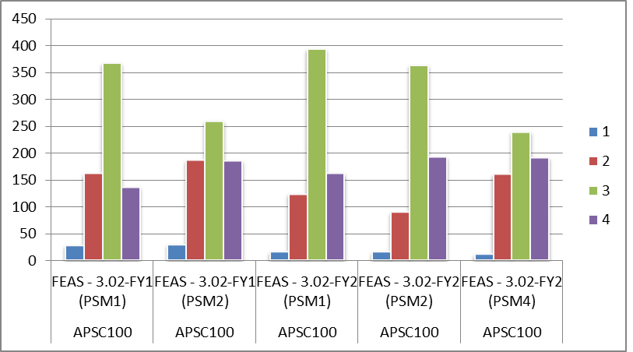
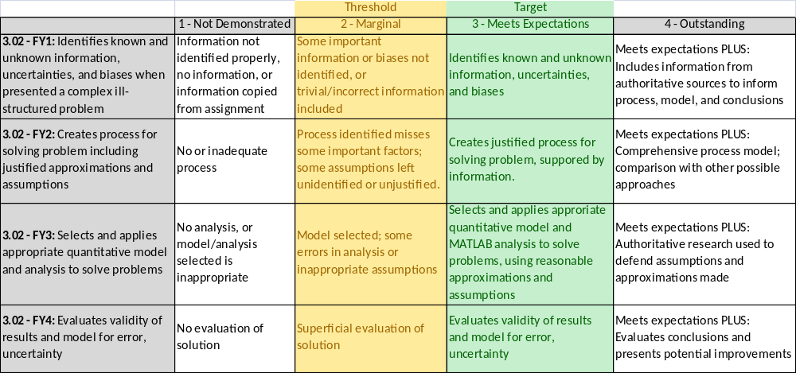

Slide 42
Pitfalls to avoid:
Johnny B. “Good”:
what is “good” performance?
NARROW:
is description applicable to all submissions?
Is descriptor aligned with objective?
Out of alignment:
bloomin’ complex:
Bloom’s is not meant as a scale!

Slide 43
Problems you will find…
Notes:
- If you haven’t done any of these things it will take some up-front time to think about learning objectives, align your course, and link to program indicators, and the first time through it probably won’t go perfectly smoothly. Those who claim it’s easy and trouble-free are either lying, happily oblivious, or pedagogical geniuses.
- It will take some iteration to get your rubrics lined up with what students deliver,

Slide 44
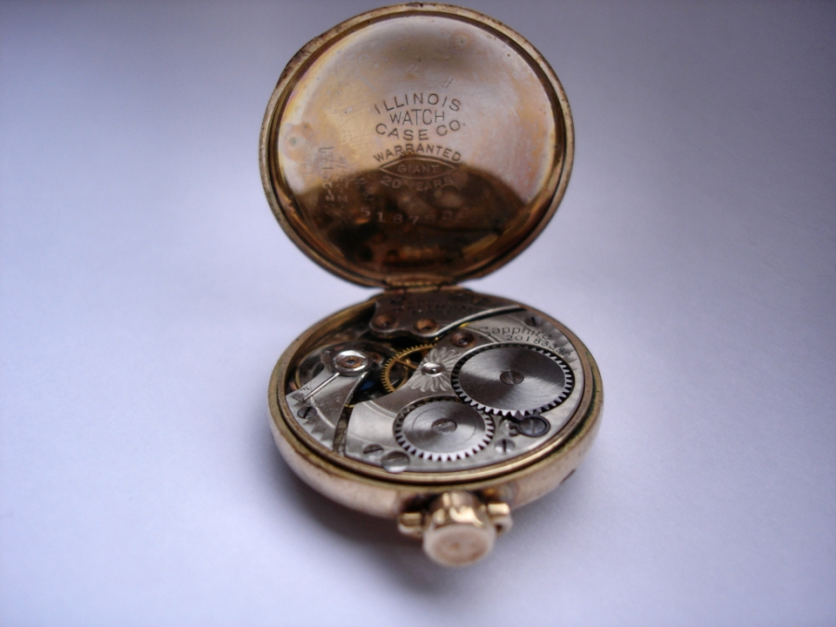
IT TAKES TIME
Notes:
With the proper application of language the indicator moves from a blunt tool to a well crafted, finely honed instrument that conveys its meaning and intent at a glance. Care should be taken to not use complicated words or phrases as these may needlessly complicate the indicator making it unwieldily and make it difficult to understand.
A good indicator should possess elegance.

Slide 45

Initially Students may not love it

Slide 46
So…
Collaboration is important
Notes:
Get some help from your centre for teaching and learning, and colleagues. Create a start and get some feedback.
Send your material to us, and we’ll give our thoughts
Pilot rubrics them with last year’s material, ask students to give their thoughts. You can also make part of an assignment or course survey to get feedback on your rubrics.
Steal rubrics from other sources – if you’re teaching a certain kind of course send us a note, and do a search on the web:
http://oiep.cofc.edu/assessment/rubics-repository.php
http://www.learningoutcomeassessment.org/Rubrics.htm#Samples
ASEE and CEEA papers
Continue working with your colleagues.
Capstone design, first year design, economics,
BMF wiki
John Biggs text

Slide 47
Continue collaboration
Network and survey
Notes:
If you are willing to be part of a network please sign the Google Doc page at: {give link}, which is a spreadsheet with Name, Institution, courses taught, and attributes of interest.

Slide 48
Graduate attribute assessment as a
COURSE INSTRUCTOR
Brian Frank and Jake Kaupp
CEEA Workshop W2-1B
http://bit.ly/KK6Rsc
Notes:
Resources: Heywood, Assessment in Higher Ed.
Rubrics book
Program evaluation book
Possible content:
Develop scoring rubrics to assist in evaluating abstract learning outcomes.
Understand the pros and cons of various data collection methods.
Utilize a planning matrix.
Create clear and concise reports on assessment processes and results.
Understand the difference between assessing program educational objectives and student learning outcomes.
Understand the challenge of engaging faculty.
Here is a brief outline of the day:
Introduction and review of key terminology
Introduction to the assessment plan cycle as it relates to continuous quality improvement
Developing measurable performance criteria
Writing scoring rubrics
Simplifying curriculum mapping
Reviewing and selecting data collection tools
Developing efficient, sustainable processes
Reviewing a planning matrix
Reporting results
Identifying faculty resistance
If you've already developed your program's objectives and outcomes, and you're looking to take the next steps in your assessment plan, this workshop is for you.

Slide 49
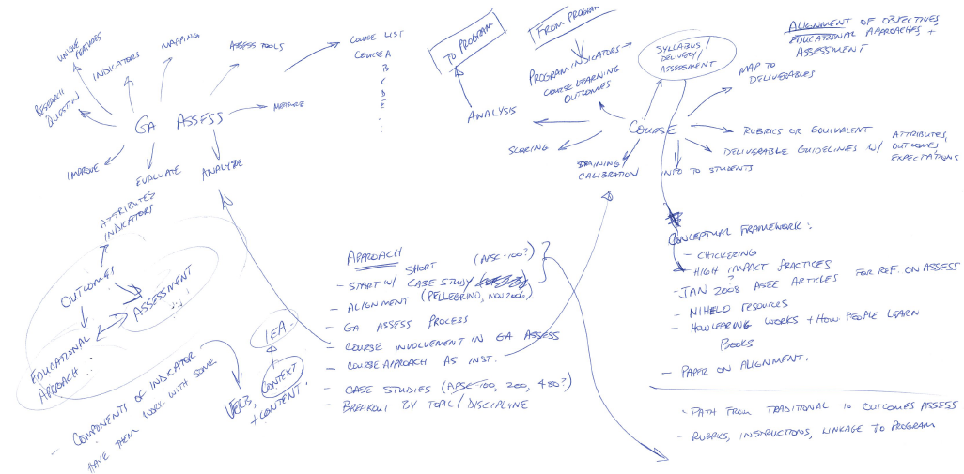

Slide 50
Models for sustaining change
Notes:
Facilitating change in undergraduate STEM instructional practices: An analytic review of the literature
Charles Henderson^{1,*},
Andrea Beach²,
Noah Finkelstein³
Journal of Research in Science Teaching
Volume 48, Issue 8, pages 952–984, October 2011

Slide 51
High impact activities
FIRST YEAR EXPERIENCES | BROAD INTEGRATING THEMES | LEARNING COMMUNITIES
WRITING INTENSIVE COURSES | UNDERGRADUATE RESEARCH | DIVERSITY/GLOBAL LEARNING
COLLABORATIVE PROJECTS | COMMUNITY BASED LEARNING | CAPSTONE COURSES
High-Impact Educational Practices: What They Are, Who Has Access to Them, and Why They Matter, George D. Kuh, Washington, DC: AAC&U, 2008.
http://www.aacu.org/leap/documents/hip_tables.pdf

Slide 52
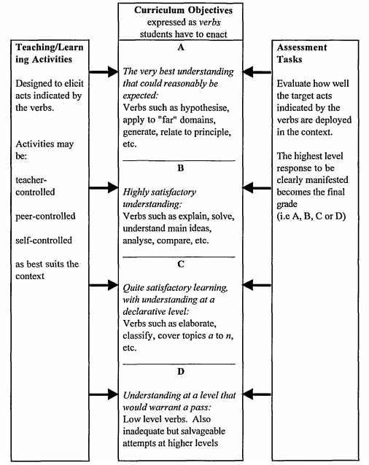
Conceptual framework
http://www.tandfonline.com/doi/pdf/10.1080/0729436990180105
John Biggs (1999): What the Student Does: teaching for enhanced learning, Higher Education Research & Development, 18:1, 57-75
Notes:
Look in Heywood,
http://www.tandfonline.com/doi/pdf/10.1080/0969595950020306
Biggs conceptual framework of constructive alignment based on

Slide 53
Activities for learning
Educational approach | Learning
Lecture | Reception of content
Concept mapping | Structuring, overview
Tutorial | Elaboration, clarification
Field trip | Experiential knowledge, interest
Learning partners | Resolve differences, application
Project | Integration, self-management
John Biggs (1999): What the Student Does: teaching for enhanced learning, Higher Education Research & Development, 18:1, 57-75

Slide 54
Example: Knowledge assessment
Calculus instructor asked questions on exam that specifically targeted 3 indicators for “Knowledge”:
  “Create mathematical descriptions or expressions to model a real-world problem”
  “Select and describe appropriate tools to solve mathematical problems that arise from modeling a real-world problem”
  “Use solution to mathematical problems to inform the real-world problem that gave rise to it”
Notes:
54

Slide 55
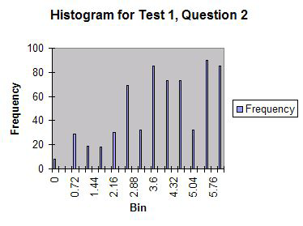
Example (cont’d):
The student can create and/or select mathematical descriptions or expressions for simple real-world problems involving rates of change and processes of accumulation (overlaps problem analysis)
Context: calculating
Intersection of two
trajectories

Slide 56
Checklist for indicators
Notes:
http://assessment.tamu.edu/asmt_help/AssessmentRubric2012_01_20.pdf

