Slide 1

Creating Useful Indicators
Brian Frank
Jake Kaupp
Peter Ostafichuck
http://bit.ly/Lo3qqW
Notes:
General Preamble: Welcome to workshop 2A, on Creating Useful Indicators. My name is Brian Frank, and assisting me is Jake Kaupp. Today we would like to work with you on creating useful indicators for educational outcomes.

Slide 2
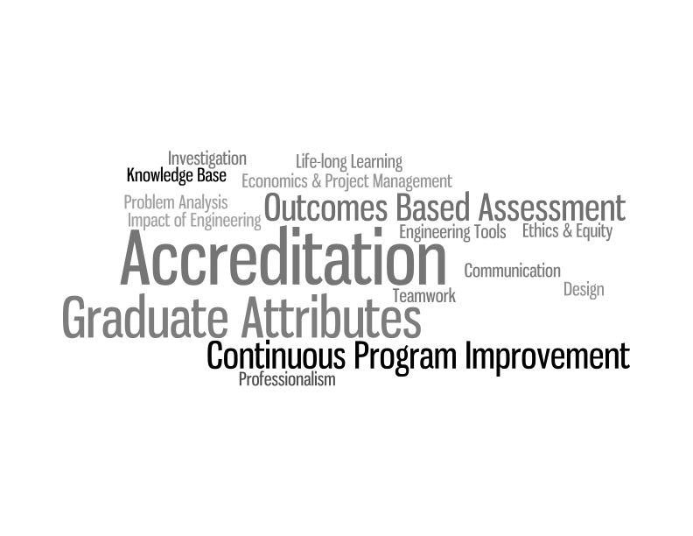
Notes:
The CEAB mandate states that engineering programs must adopt an outcomes based process, and have specified 12 learning outcomes, or graduate attributes, that all Canadian engineering graduates should embody. Programs must be able to assess, measure and perform curriculum improvement based upon these 12 attributes.

Slide 3
CONTINUOUS PROCESS
OF
PROGRAM IMPROVEMENT
INFORMED BY DATA.
Notes:
Continous – efficient, integrated into program delivery and assessment
Program – collaborative and must be understood by multiple parties
Data – data collected on student performance

Slide 4
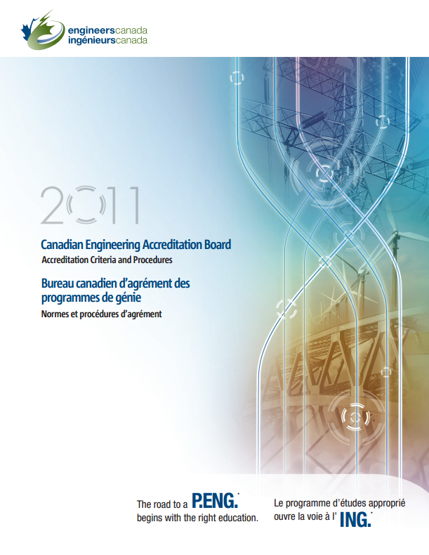
CEAB requirements include:
indicators that describe specific abilities expected of students
A mapping of where attributes are developed and assessed within the program
Description of assessment tools used to measure student performance (reports, exams, oral presentations, …)
Evaluation of measured student performance relative to program expectations
a description of the program improvement resulting from process

Slide 5
1
2
Program objectives and indicators
Mapping the curriculum
What do you want to know about the program?
Curriculum & process improvement
Analyze and interpret
Collecting data
5
4
3
Notes:
General process informed by what do you want to know that is particular to your program – do you have a special stream you want to know more about? Do you have long-standing issues? Have you had concerns about a specific attribute?
In other established outcomes-based processes in engineering education, such as ABET’s EC2000 and (insert others), have intentionally left the universal outcomes vague, in order to encourage individual programs to distinguish themselves within their respective programs. Typically, programs created program specific objectives, and then developed the own learning outcomes from these objectives. In this case, the CEAB has termed these mid-level learning outcomes, indicators.
But what makes a GOOD indicator?
What do you want to know to improve your program? What innovative features do you want to study? What ongoing problems have you had?
These serve as guides as you create indicators, map your program, select people to be involved.

Slide 6
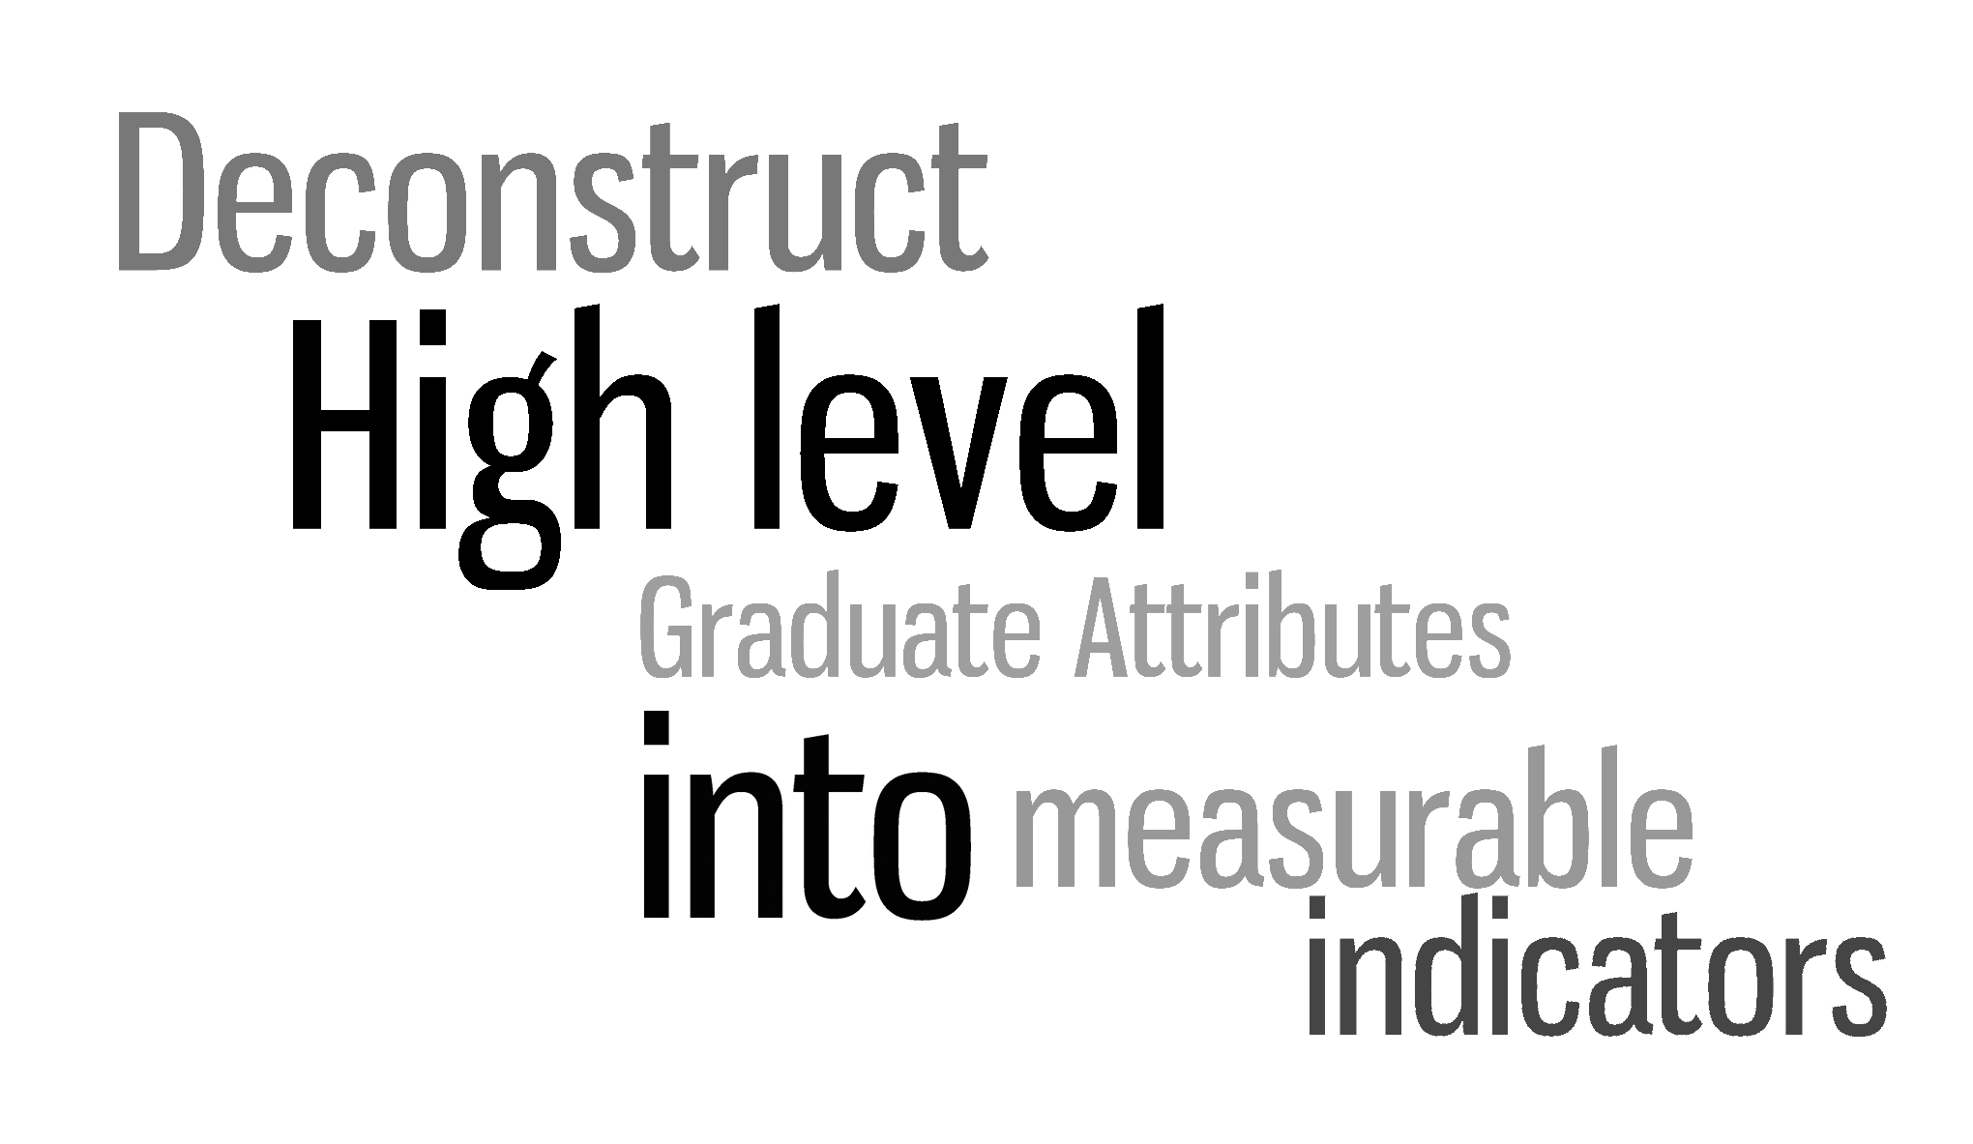
Notes:
However, the 12 attributes don’t lend themselves particularly well to assessment and measurement. In order to assess and measure these broad, complex, high-level attributes we should deconstruct them to their essence and create a less-complex set of elements that capture the intent of their respective attribute, but are easily assessed and measured.

Slide 7
Indicators: examples
Lifelong learning
An ability to identify and address their own educational needs in a
changing world in ways sufficient to maintain their competence and to
allow them to contribute to the advancement of knowledge
Graduate
attribute
The student:
Critically evaluates information
for authority, currency, and
objectivity when referencing
literature.
Identifies gaps in knowledge and
develops a plan to address
Indicators
Describes opportunities for
future professional
development.
Monitors, evaluates, and works
to improve own learning

Slide 8

“Everything should be made as simple as possible, but not simpler.”
~Einstein
Notes:
Indicators are everywhere. The most successful indicators are unobtrusive, pervasive and highly functional, and provide information about a system. E.g. economic leading indicators – employment rate, GDP change,
The battery indicator is a prime example. It is a supremely simplistic design, but is highly functional, conveying a great deal of information at a glance though colour, shape and progression. Upon looking at the indicator, you quickly understand its meaning.
A good indicator should be simple.

Slide 9
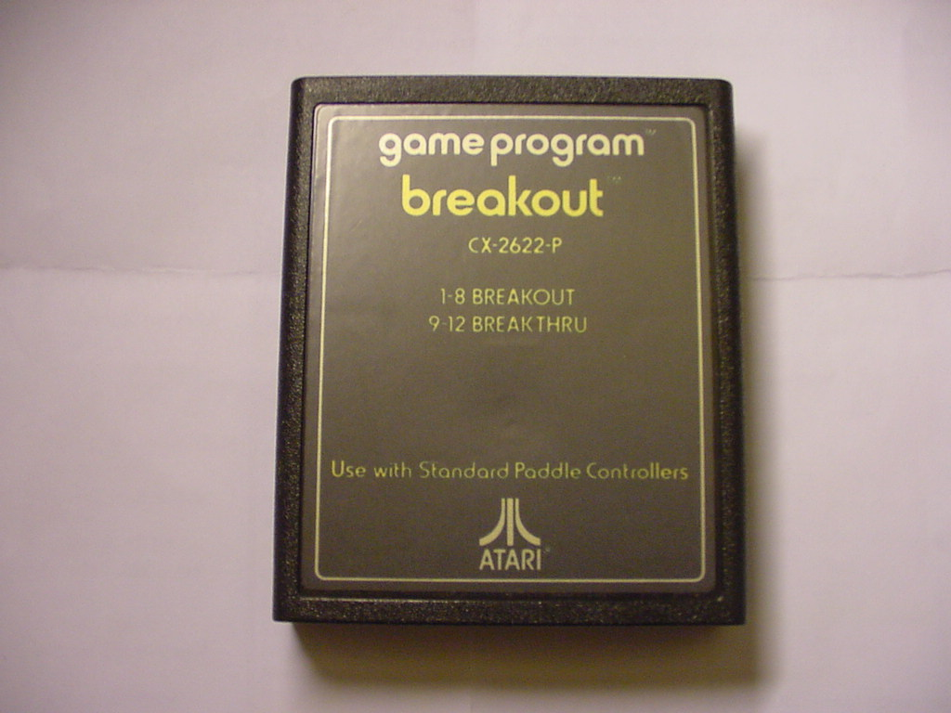
Notes:
With these principles in mind, we would like to invite you along with the other members of your table to participate in a breakout exercise.

Slide 10
“The student understands morphological matrices.”
“The student reads scholarly articles in the field.”
“The student defines open-ended problems presented by client.”
Notes:
Your group is a curriculum committee, evaluating draft indicators for a 4th year capstone course. Assessments are planned around specialized tutorials and weekly progress meetings, and these draft indicators have been provided by the instructor:
For these indicators, we would like you to discuss how they could be improved, and how they could be assessed.
After they work on it, gather their attention, and facilitate a discussion about each indicator and how useful it is.
Are they measurable?
Is it meaningful for monitoring student performance and making improvement?
Common problems: overly vague, overly specific,
Examples: not measurable, not an outcome, overly specific, not useful for improving program

Slide 11
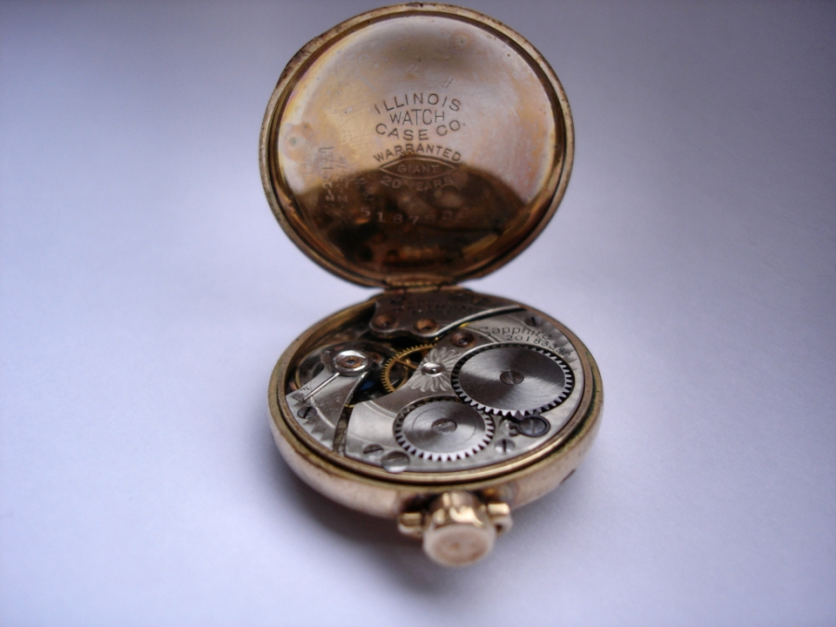
INDICATORS MUST BE
MEASURABLE
Notes:
An indicator must be measurable. If you can’t measure the learning outcome by observing student behaviour or something created by the student, then how can you determine how well your curriculum is preparing students?
A good indicator should always be able to be measured either by direct or indirect means.
Anything about what happens inside their head isn’t observable – the behaviour resulting from the internal process is. The cognitive functioning is an interal state.

Slide 12

INDICATORS MUST BE
MEANINGFUL
Notes:
An indicator should be meaningful. You can produce many shallow indicators to describe a learning outcome, but a well constructed indicator will have meaning to all parties: students, educators, administrators and researchers.
If it doesn’t mean anything to you, it’s not useful.
Using Professionalism: “Students will develop technical communication skills”
This has little meaning. In order to make the indicator more meaningful to all parties, a more detailed description may be used.
“Students employ professional language and standards in written communications”
This example has meaning for all parties involved. The indicator provides a level of evaluation (professional language and standard), what is being evaluated (written communications) and a more descriptive verb.

Slide 13
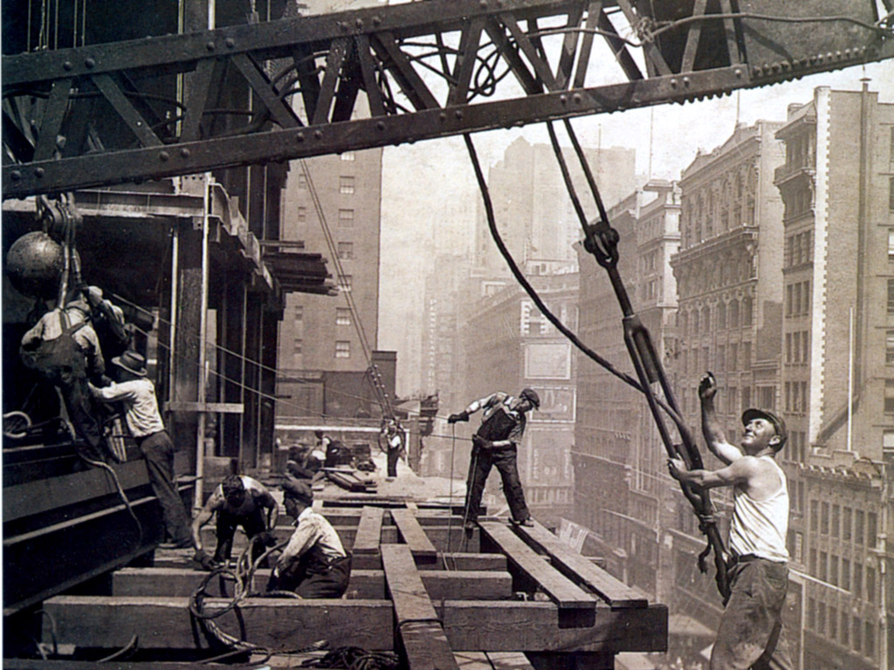
Structure of an indicator
Notes:
Now that we’ve seen some examples of improperly constructed indicators, we can investigate into the proper structure of an indicator.
The structure of an indicator compliments the design elements we touched on earlier and works harmoniously with each other, rather than being opposed.

Slide 14
Apply a design process to solve an open-ended complex problem as provided by a mentor.
1.Verb
2. Content
3. Context
Notes:
The content of an indicator is very important as it classifies the knowledge involved. The content of the indicator should be descriptive yet concise. The content of an indicator is typically the thing, skill or development that is being assessed.
In the case of previous example, our content in the first ‘bad’ indicator was “technical communication skills” which was not particularly meaningful or descriptive and is rather vague.
The ‘improved’ indicator uses “professional language and standards in written communications” which is descriptive and gets right to the point in what knowledge is involved an what is being assessed and where it is assessed. Professional language and application of standards is being assessed within written communications.

Slide 15
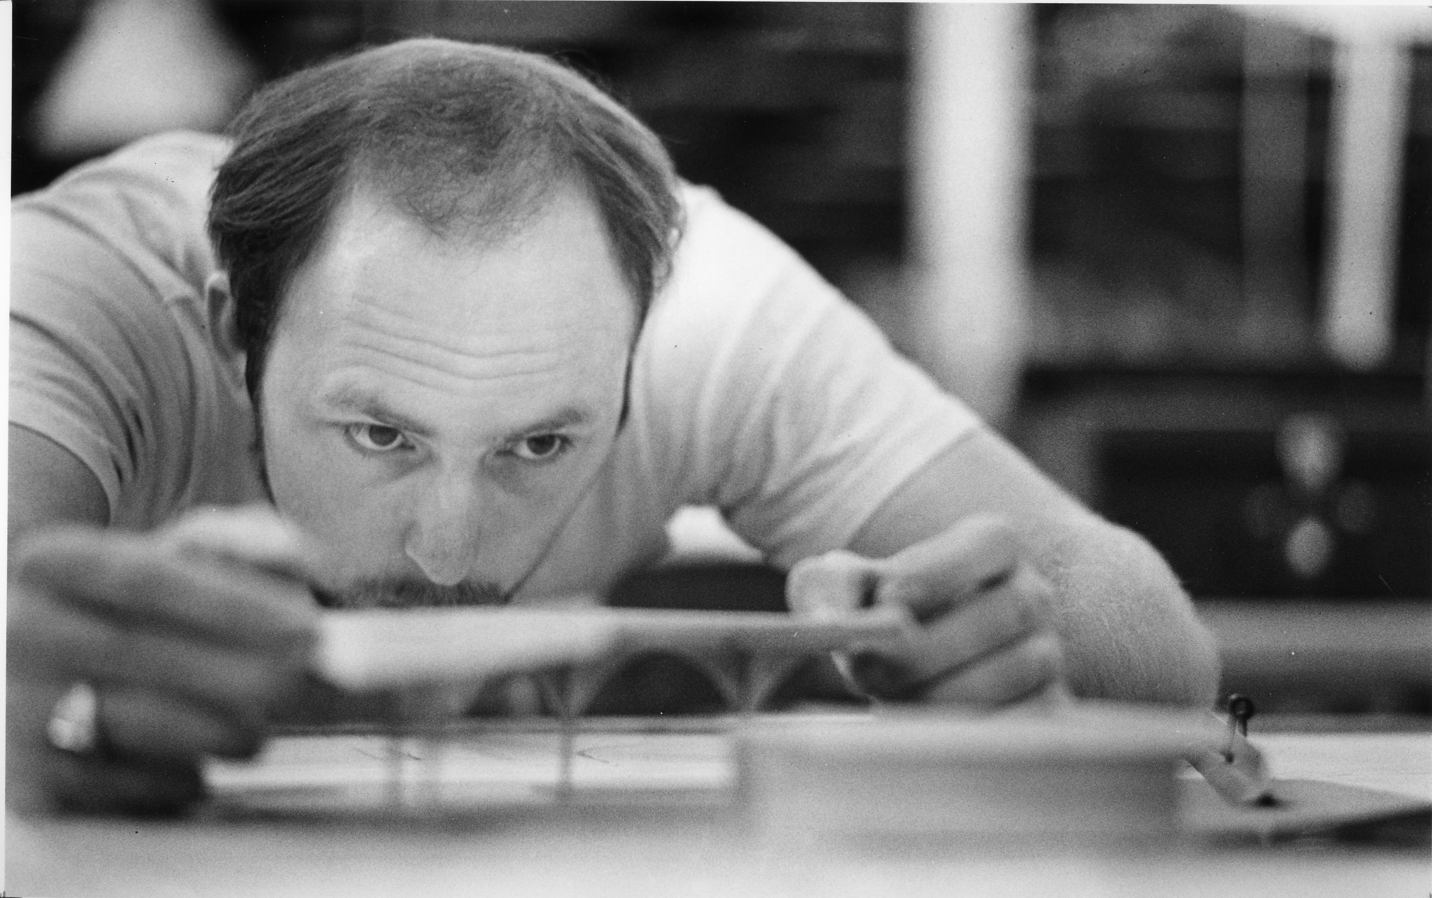
Taxonomies
“These are operations to enable teachers to realize the seductive dream which drew them into education—the fullest development of the students ”
Benjamin Bloom
Notes:
Verb selection is very important, as verbs will denote the activity and level of involvement in your indicators. (flesh this out)
There are many different schools of verb usage, with Bloom’s taxonomy being one of the most widely used, having associated certain verbs with different learning expectations in the cognitive and affective domains.

Slide 16

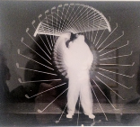

Cognitive / Knowledge
Affective / Habits of Mind
Psychomotor / Physical Skills
(Bloom, B. S., Engelhart, M. D., Furst, E. J., Hill, W. H., & Krathwohl, D. R. (1956). Taxonomy of educational objectives: the classification of educational goals; Handbook I: Cognitive Domain New York, Longmans, Green, 1956. )
Notes:
Cognitive: knowing, problem solving, creating processes
Psychomotor: skills (test and measurement, machining, constructing)
Affective: showing respect for others, teaming, conflict resolution, adherence to code of ethics, time management

Slide 17
Taxonomy
“Bloom’s” (cognitive)
Bloom’s (affective)
Creating
(design, construct, generate ideas)
Evaluating/Synthesizing
(critique, judge, justify decision)
Internalizing
(acts, shows, practices)
Analyzing
(compare, organize, differentiate)
Organizing
(relates beliefs, balances)
Applying
(use in new situation)
Valuing
(demonstrates belief in, sensitive to)
Understanding
(explain, summarize, infer)
Responding
(answers, performs, practices)
Remembering/Knowing
(list, describe, name)
Receiving
(asks, describes, points to)
Anderson, L. W. and David R. Krathwohl, D. R., et al (Eds..) (2001) A Taxonomy for Learning, Teaching, and Assessing: A Revision of Bloom's Taxonomy of Educational Objectives

Slide 18
Taxonomy
Psychomotor (“skills”)
Origination
(create new motion as needed)
Adaptation of responses
Complex response
Mimic simple actions

Slide 19
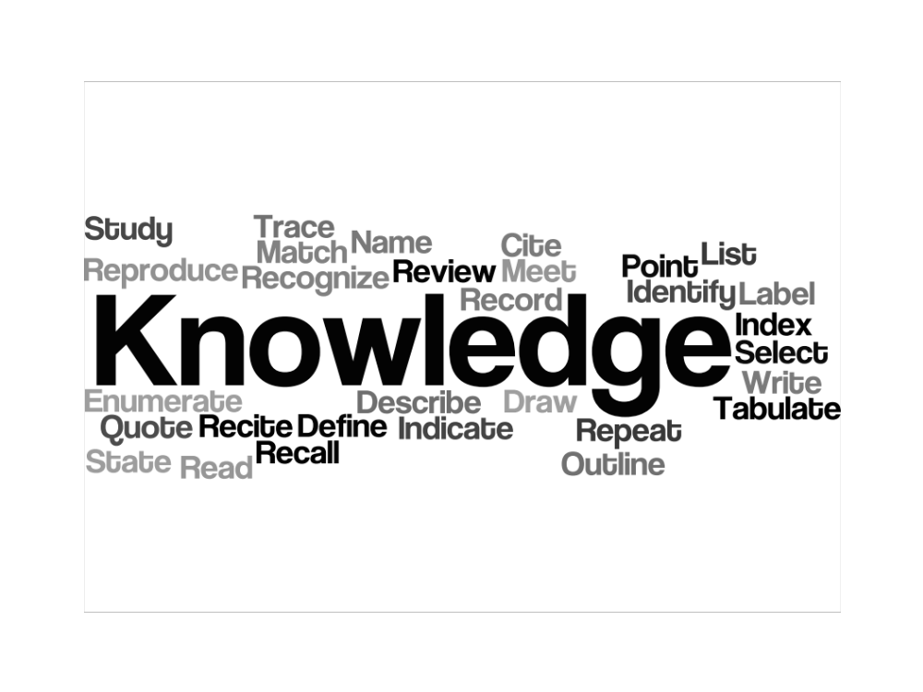

Slide 20
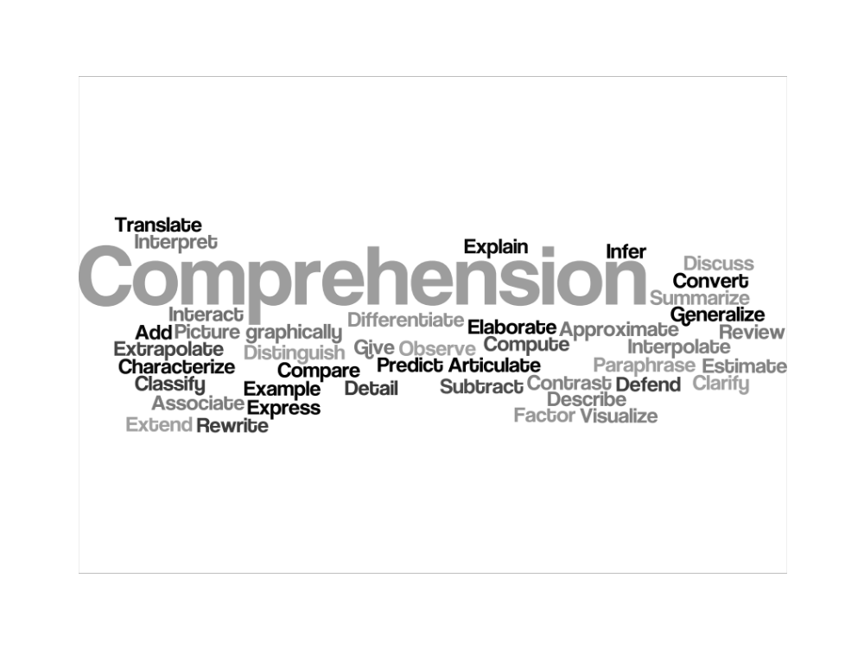

Slide 21
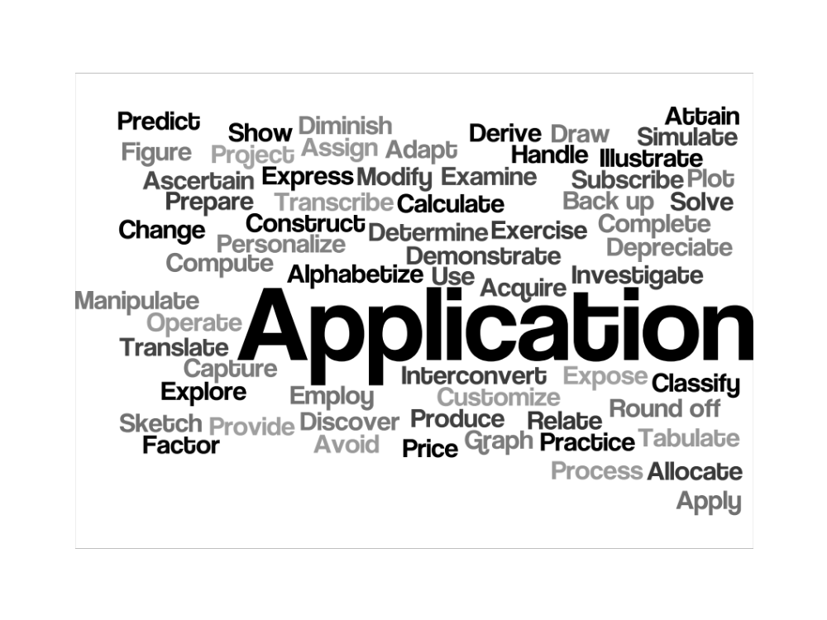

Slide 22
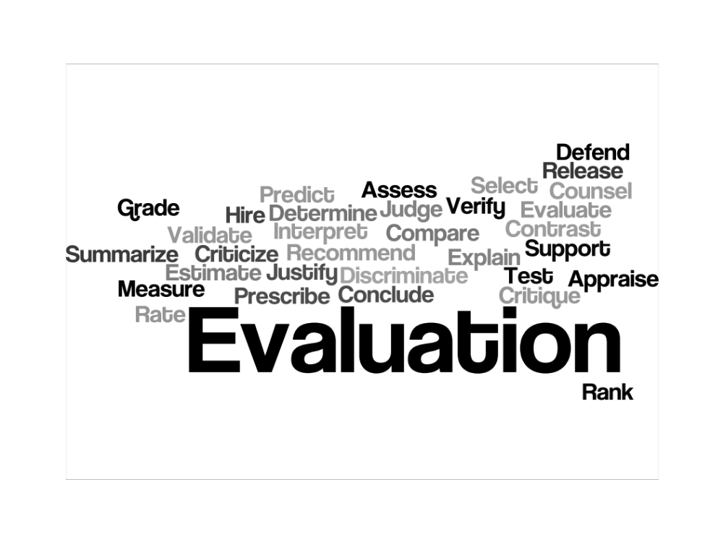

Slide 23
Open to many interpretations… | Open to fewer interpretations…
To KNOW | To WRITE
To UNDERSTAND | To RECITE
To ENJOY | To IDENTIFY
To APPRECIATE | To DIFFERENTIATE
To GRASP THE SIGNIFICANCE OF | To SOLVE
To COMPREHEND | To CONSTRUCT
To BELIEVE | To LIST
 | To COMPARE
 | To DEMONSTRATE

Slide 24
Indicators: verbs, content and context
Follow a provided design process to design system, component, or process to solve an open-ended complex problem as directed by a mentor.
Employ and apply design processes and tools with emphasis on problem definition, idea generation and decision making in a structured environment to solve a multidisciplinary open-ended complex problem.
Applies specified disciplinary technical knowledge, models/simulations, and computer aided design tools and design tools in a structured environment to solve complex open-ended problems
Selects, applies, and adapts disciplinary technical knowledge and skills and design concepts to solve a complex client-driven open-ended problems

Slide 25
Possible approaches to creating indicators from attributes
1. Critical stages in a process (design, problem solving)
2. Elements of a whole
  Communications – written, graphical, oral, team
  Problem solving – analytical/synthesis, divergent/convergent thinking
  Lifelong learning – self-regulation, information management, critical thinking, opportunities for ongoing development

Slide 26
Context table
Characteristics | Indicators are assessed in the context of activities with the following characteristics…
Complexity | Process requires abstract thinking and is not immediately apparent, often involving unknown or conflicting information and constraints
Depth of knowledge and analysis | Requires knowledge fundamentals-based, first principles approach
Familiarity of issues | Involve infrequently encountered issues
Interdependence | Are high level activities including many elements or sub-problems
Innovation | Involve creative use of principles and research-based knowledge in novel ways.
Autonomy | Require students to determine processes and methods and taking initiative in interactions with others

Slide 27
Example of context by year
Characteristic | First year | Second year | Third year | Fourth year
Problem complexity | Realistic non-disciplinary client-based projects. Limited interdependent subsystems and goals. | Stakeholders and performance criteria easily identifiable and small in number | Broadly defined problem, e.g. subsystem with defined interface constraints. | Requires abstract thinking not immediately apparent, often involving unknown or conflicting information and constraints
Depth of analysis and knowledge | Technical analysis required if appropriate to project | Integration of technical analysis as needed to justify project solution(s) with focus on process & tools, not analysis | Integration of design & professional practice with accurate and technically appropriate analysis | Requires fundamentals-based first principles concepts and self-acquired knowledge within or beyond discipline
Reflection | Required to evaluate own process based on provided criteria | students guided through instruction and reflective exercises to encourage self-evaluation | students mentored to reflect and evaluate on an ongoing basis | students expected to reflect and evaluate on an ongoing basis
Degree of uncertainty | At least one known path to success | multiple known paths to varying levels of success | constrained open-ended problems should be solvable but with multiple acceptable solutions | Path to conclusion not necessarily known at beginning; unknown outcome, “successful” failure is an option.
Creativity and novelty | Encourage creativity, but problem not necessarily novel | Encourage creativity, but problem not necessarily novel | Encourage creativity, but problem not necessarily novel | Best solution not obvious, creative thinking and originality required

Slide 28

Ideas
Connections
Extensions
Notes:
Another taxonomy and verb collection for your toolbox is a system based off of Bloom’s by Sue Fostaty-Young called ICE: Ideas, Connections and Extension. They are a simpler collection of verbs for different levels of cognitive, psychomotor, and affective processes.

Slide 29
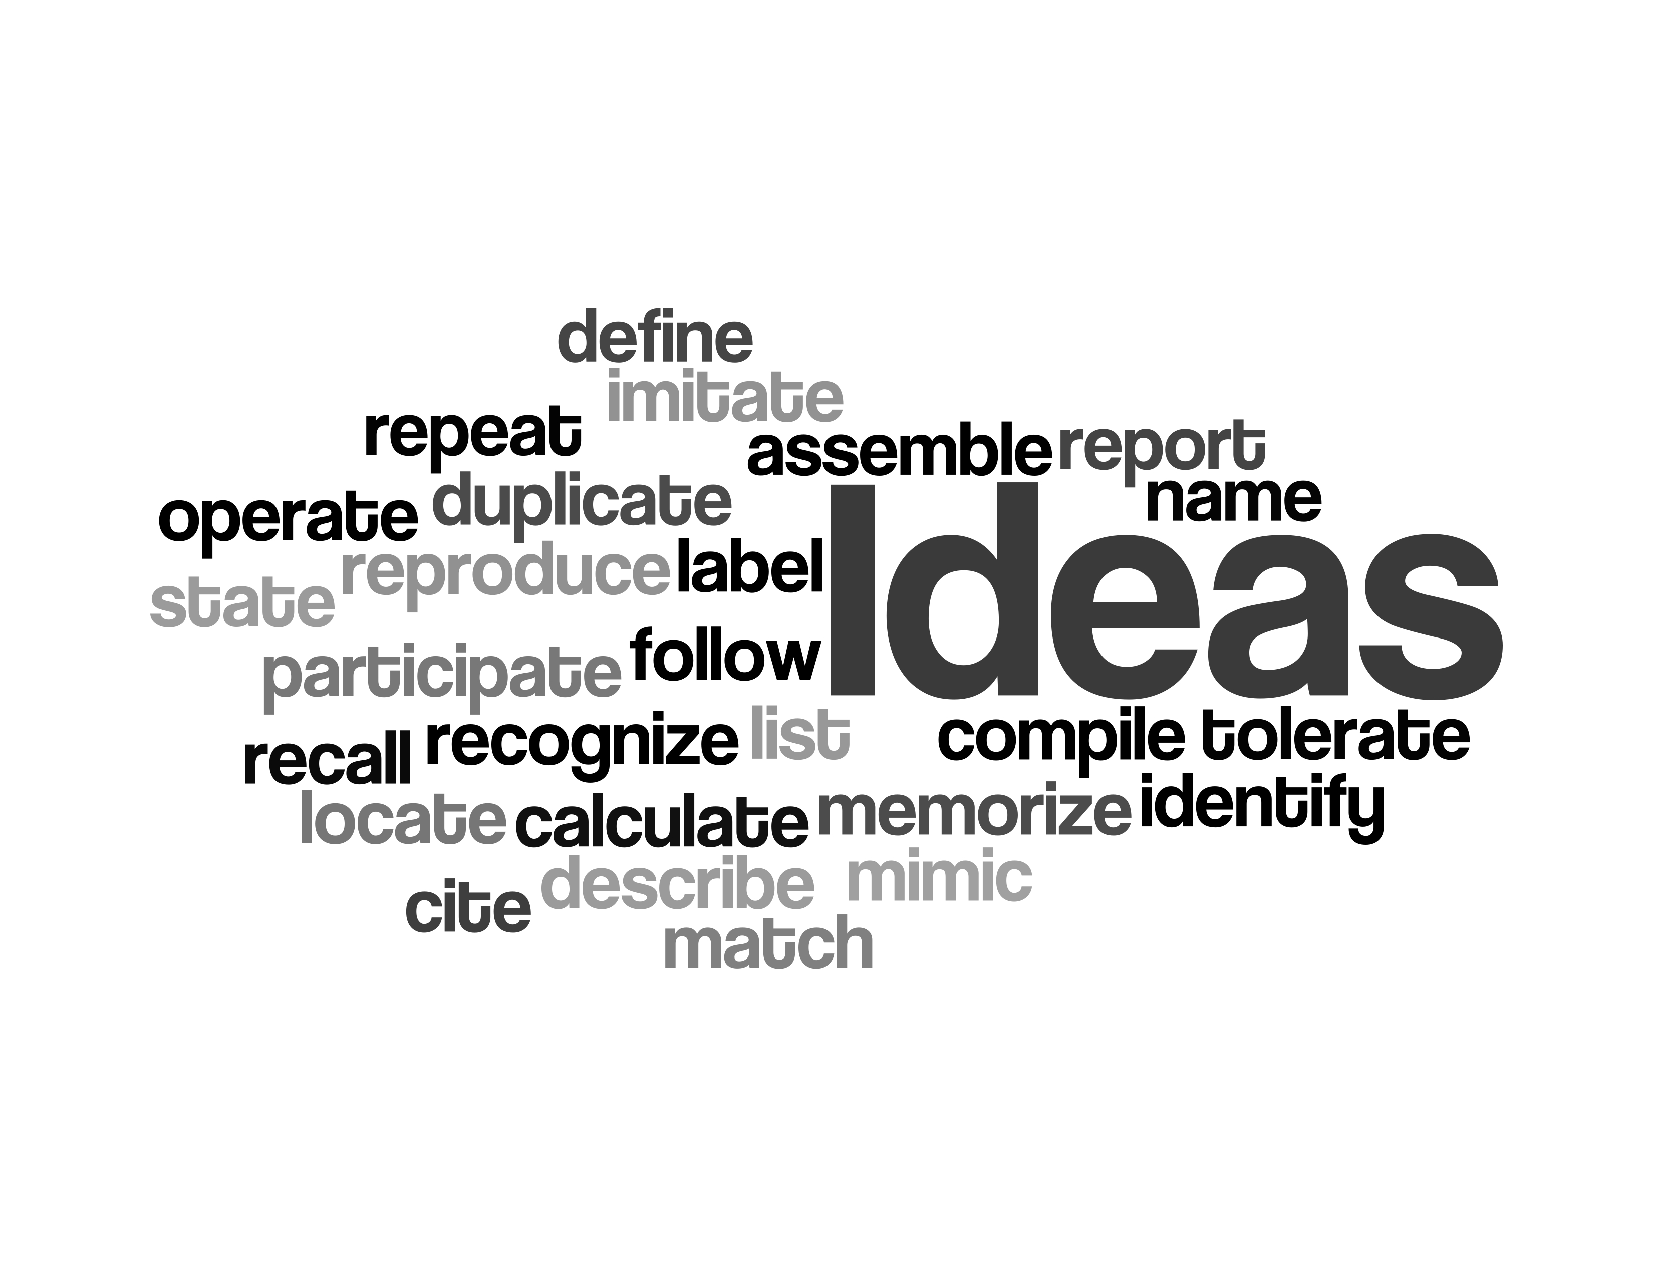
Notes:
The ideas represent the initial learning expectation, that learners are able to engage in learning at the surface level. The learners are able to conceive the idea that was taught.

Slide 30
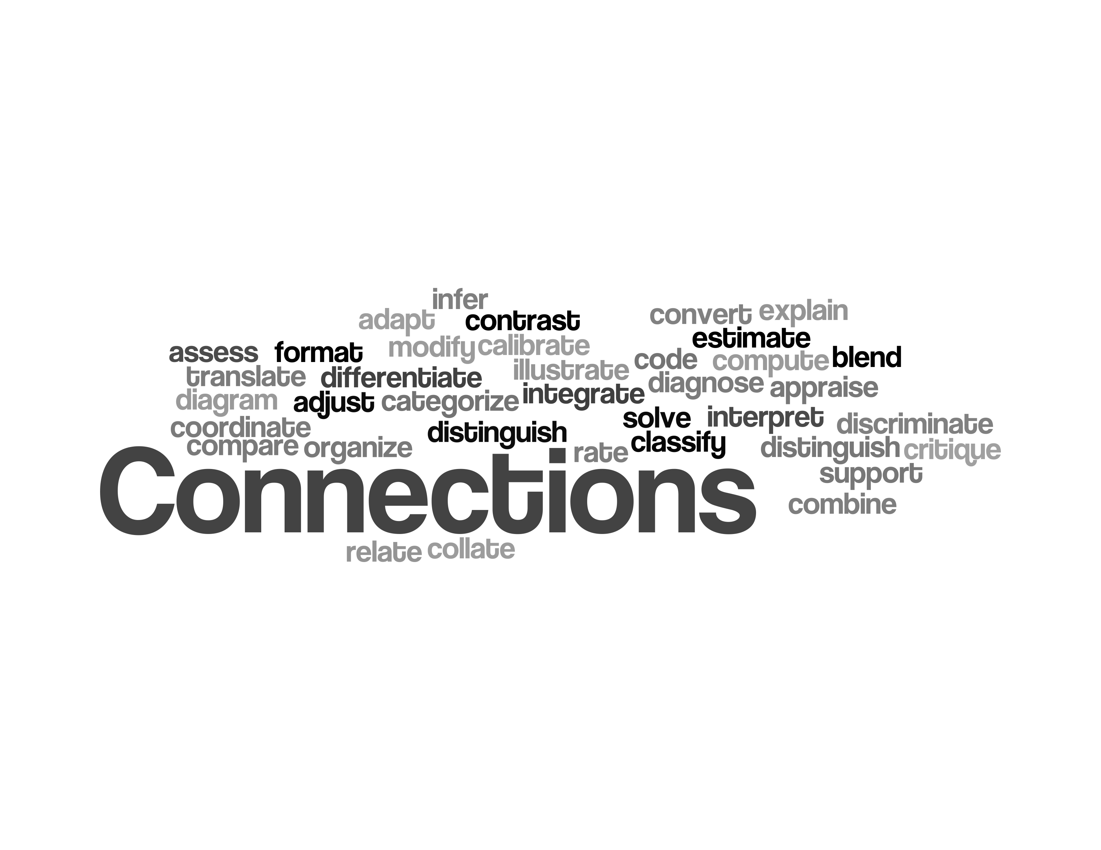
Notes:
Connections represents the level when learners are able to make the link between the ideas taught and the rest of their knowledge. They begin to make connections between what they have learned and the world.

Slide 31
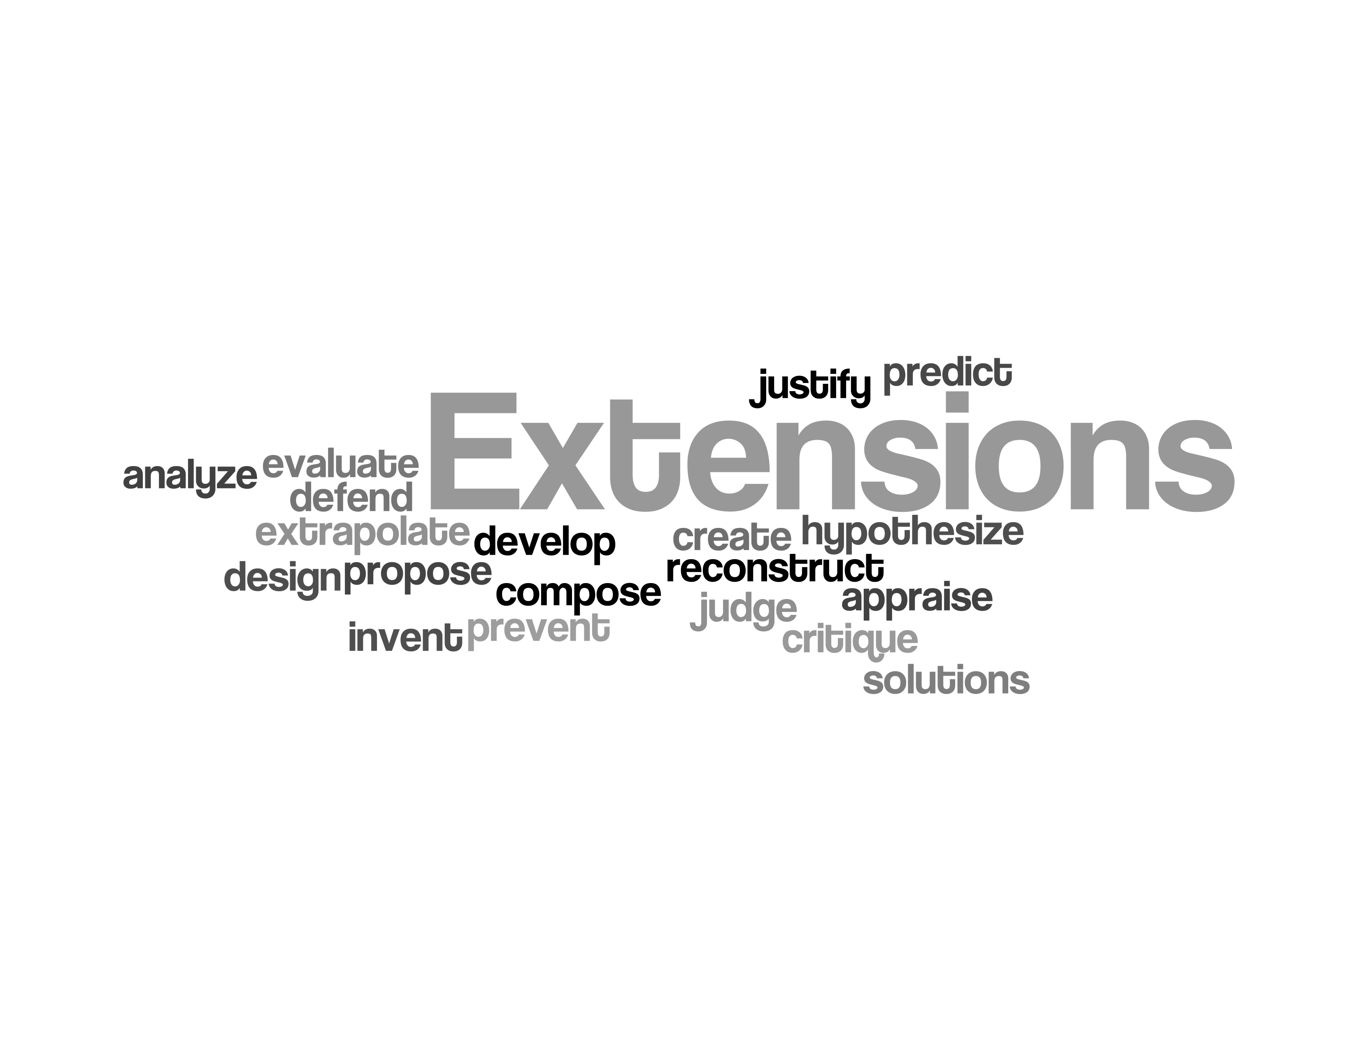
Notes:
Extensions represents the step beyond connections where learners begin to stretch the limits of their knowledge and extend the reach of their knowledge to unforeseen problems and issues, and the inter-related nature of their knowledge. They begin to be able to fully apply the ideas and connections made in previous steps.

Slide 32

Notes:
We would again like you to participate in final breakout session. However, this time we would like you to group yourselves by the graduate attribute you would most like to develop indicators for.
We’ve place signs at each table for each Graduate Attribute, please join them and we’ll go over what we would like you to do.
Your table is a Curriculum Development committee drafting indicators for your chosen attribute for a 4th year capstone course. Please feel free to use the indicators you brought with you, or develop ones with your group. Once you’ve developed or volunteered indicators, please vote amongst the group for the indicator that you would like to see worked further, with all workshop participants.
We’ve created a google spreadsheet with tabs for each of your groups. Please input the indicator or indicators that you’ve determined you want to work on further in your tab and save your work. We will then discuss indicators for each attribute.

Slide 33
Pitfalls to avoid:
Johnny B. “Good”:
What is “good” performance?
unmeasurable:
Can you observe it?
Is indicator aligned with attribute?
Out of alignment:
reliable:
Can multiple graders agree on it?
Notes:
Validity and reliability of the data: will you be able to trust what comes out of the assessment?

Slide 34

Indicators should be measureable and meaningful
Indicators should have: content, context, and verb
Indicators should be useful to YOU to help students.
Notes:
Resources: Heywood, Assessment in Higher Ed.
Rubrics book
Program evaluation book
Possible content:
Develop scoring rubrics to assist in evaluating abstract learning outcomes.
Understand the pros and cons of various data collection methods.
Utilize a planning matrix.
Create clear and concise reports on assessment processes and results.
Understand the difference between assessing program educational objectives and student learning outcomes.
Understand the challenge of engaging faculty.
Here is a brief outline of the day:
Introduction and review of key terminology
Introduction to the assessment plan cycle as it relates to continuous quality improvement
Developing measurable performance criteria
Writing scoring rubrics
Simplifying curriculum mapping
Reviewing and selecting data collection tools
Developing efficient, sustainable processes
Reviewing a planning matrix
Reporting results
Identifying faculty resistance
If you've already developed your program's objectives and outcomes, and you're looking to take the next steps in your assessment plan, this workshop is for you.

Slide 35
Creating Useful Indicators
Brian Frank
Jake Kaupp
Peter Ostafichuck
Materials:
http://bit.ly/Lo3qqW
EGAD surveys:
General Audience Survey : http://svy.mk/Mk4XsP
Process Planner Survey : http://svy.mk/N6o3aB
Notes:
Encourage continued interaction
All presentation materials, including notes for the slides are available on the EGAD website, along with additional materials and references to papers on developing indicators and learning outcomes.
EGAD survey

