Slide 1
Workshop 2B:
What to Look for in an Outcomes-Based Process
Peter Wolf
Director
Centre for Open Learning & Educational Support
University of Guelph
Susan McCahan
Vice-Dean, Undergraduate
Faculty of Applied Science
University of Toronto
Brian Frank (project coordinator), Queen’s University
Susan McCahan, University of Toronto
Lata Narayanan, Concordia University
Nasser Saleh, Queen’s University
Nariman Sepehri, University of Manitoba
Peter Ostafichuck, University of British Columbia
K. Christopher Watts, Dalhousie University
Peter Wolf, University of Guelph
Notes:
Susan

Slide 2
Workshop Outcomes:
What makes for a sustainable, effective outcomes-based curriculum improvement process? In this workshop we will examine the parts of an outcome-based curriculum improvement process and identify the characteristics of a high quality process. We will also discuss common flaws that can undermine an outcome-based process; learn how to identify such flaws, and how to correct them. Short case studies will be used to give participants an opportunity to apply what they are learning in the workshop.
You should be able to
Identify the characteristics of a high quality outcomes-based curriculum improvement process
Begin to provide an informed critique of a continuous curriculum improvement process
Notes:
pw

Slide 3
Agenda: What to look for
- overall
- at each step
Data-informed curriculum improvement:
Setting priorities and planning for change
1. Program
Evaluation:
Defining purpose
and indicators
Analyzing
and Interpreting
the data
Stakeholder input
3. Identifying and Collecting Data
2. Mapping
the Curriculum

Slide 4

Perspective: Sec 3.1 of CEAB Procedures
“The institution must demonstrate that the graduates of a program possess the attributes under the following headings... There must be processes in place that demonstrate that program outcomes are being assessed in the context of these attributes, and that the results are applied to the further development of the program.”

Slide 5
Activity: How do we ideally critique a research report, journal article, or grant proposal?

Slide 6
Frame this as a research study on your curriculum
From perspective of learners, and outcomes
NOT inputs, teaching

Slide 7
Overall process
What to look for:
Research questions and methodology are well defined and align with outcomes
Process is includes all key elements
Process is well defined and sustainable
Process is continuous:
cycle of data collection and analysis is explained

Slide 8
Research Questions: case study
What are students’ strengths and weaknesses in communication ability after completing our program?
There are several courses we think teach and utilize investigation skills; where are students really learning to investigate a problem?
Where does the program cover project management?
How many times do students participate in team based projects?
Does our students’ problem solving ability meet our expectations?

Slide 9
Sample Process Framework (cont’d)
Example 1: data collection by attribute
Task | 2011/ 12 | 2012/ 13 | 2013/ 14 | 2014/ 15
Group 1 Attributes | X
Group 2 Attributes |  | X
Group 3 Attribute |  |  | X
Integration of all Attributes |  |  |  | X
Example 2: classic longitudinal study in 12 dimensions (i.e. cohort follow )
Task | 2011/ 12 | 2012/ 13 | 2013/ 14 | 2014/ 15 | 2015/16
Year 1 | - | X |  |  | X
Year 2 | - |  | X
Year 3 | - |  |  | X
Year 4 | - | X |  |  | X

Slide 10
Sample Process Framework (cont’d)
Example 3: data collection by snapshot
Task | 2011/ 12 | 2012/ 13 | 2013/ 14 | 2014/ 15 | 2015/16
All attribute areas | X |  |  |  | X
Report data for visit |  | X
Example 4: Data collection on all attributes at graduation
Task | 2011/ 12 | 2012/ 13 | 2013/ 14 | 2014/ 15 | 2015/16
Year 4 | X | X | X | X | X
Example 5 Collect data on every attribute every year across the whole curriculum

Slide 11
Sample Process Framework (cont’d)
Example 1
Task | 2012-13 | 2013-14 | 2013/ 14 | 2014/ 15
Graduate Survey | X | X | X | X
Student Portfolios Review
Student/Faculty Feedback |  |  | X
Alumni Survey |  | X
Employer Focus Group | X
Faculty& Student Workshops/Retreat | X | X | X
Review assessment process & adapt |  |  |  | X

Slide 12
1 Program Evaluation: Getting Started
2 Mapping the Curriculum
5 Data-Informed Curriculum Improvement:
Setting Priorities and Planning for Change
3 Identifying and collecting
data on student learning
4 Analyzing and Interpreting the Data
Notes:
pw

Slide 13
1. Program Evaluation: Defining purpose and indicators
Graduate Attributes: 12 defined by CEAB
Characteristics of a graduating engineer
A broad ability or knowledge base to be held by graduates of a given undergraduate engineering program
Indicators:
Descriptors of what students must do to be considered competent in an attribute; the measurable and
pre-determined standards used to evaluate learning.

Slide 14
Indicators
1) For Attribute #3 (Investigation), which of the following potential indicators are appropriate?
  Complete a minimum of three physical experiments in each year of study.
  Be able to develop an experiment to classify material behaviour as brittle, plastic, or elastic.
  Be able to design investigations involving information and data gathering, analysis, and/or experimentation
  Learn the safe use of laboratory equipment
  Understand how to investigate a complex problem
2) What are other potential indicators for
this attribute?
3) How many indicators are appropriate for
this attribute? Why?
Investigation:
An ability to conduct investigations of complex problems by methods that include appropriate experiments, analysis and interpretation of data, and synthesis of information in order to reach valid conclusions

Slide 15
1. Program Evaluation: Defining purpose and indicators
What to look for:
Indicators align with attributes and research questions
Indicators are “leading indicators”:
central to attribute; indicate competency
Enough indicators defined to identify strength areas; and weak areas (but not too many)
Indicators are clearly articulated and measurable

Slide 16
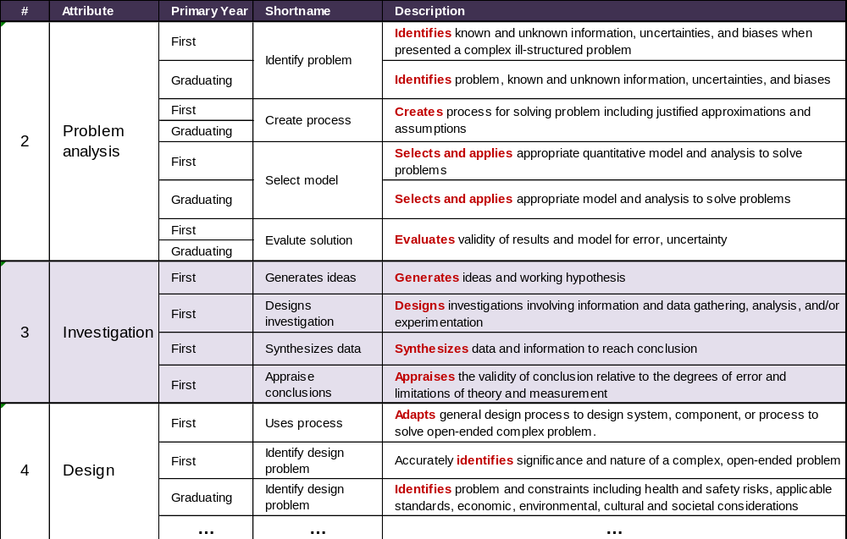
Example: Adapted from Queens, 2010

Slide 17
2. Mapping the Curriculum
Goal:
  Where are the students learning?
  Where are we already assessing learning?
  Start to identify assessment checkpoints

Slide 18
2. Mapping the Curriculum
What to look for:
Information in the map is
  Accurate, with some depth, identifies outcomes
  Not simply a list of topics “covered”
Map provides information for each attribute
  Can include curricular and other experiences
Map indicates where the attribute is:
  Taught: possibly with some information
  Assessed
  Points of planned data collection

Slide 19
Curriculum Assessment Case Study
Curriculum Context:
Small applied sciences undergraduate with approximately 200 students
20 faculty (40% of whom are non-native English speakers) with no sessional/contract instructors
Question:
There is a suspicion and concern amongst faculty that the writing skills of students is lower than desired. Is this the case? If so, how to adapt curriculum & related practices to further enhance student writing

Slide 20
Data Collection:
Map writing to courses
Survey of student work
Student survey on writing development
Department meeting discussion (including TAs, contract instructors, academic counselors, etc.)

Slide 21
  Relevant qualitative data:
  Students wish they had more opportunities to develop writing skills
  Samples show consistently lower-than-desired level of sophistication
  The department meeting included discussion about:
    The large international proportion of faculty
    The appropriateness of scientists teaching writing
    A reluctance to teach and assess writing in general from faculty
    A lack of resources and tools for those faculty interested but unsure how to go about it

Slide 22
Courses available to Majors

Slide 23
Mapping Writing

Slide 24
Continuous improvement of the curriculum can lead to:
Superior graduating students
Evidence of graduating student quality
Opportunity for individual student & programme autonomy
Enhanced time & resource usage
Note: in the Graduate Attributes process
curriculum mapping is a step toward outcomes assessment, not the end goal
can yield important insights into curriculum and improvement opportunities
Notes:
Both

Slide 25
3. Collecting Data on Student Learning
Data collection can include:
  Qualitative data
  Quantitative data
Ultimately is translated into information that addresses the research questions
  On the indicator being assessed
  At a particular, identified point in the program

Slide 26
3. Collecting Data on Student Learning
What to look for:
Assessment aligns with indicator; i.e. valid data
Triangulation is used: i.e. reliable data collection
within reason
Assessment scoring is well designed
levels are well described, and appropriate
Assessment avoids “double barreled” (or more) scoring
Sampling is used appropriately
Data collected for assessing the program/cohort quality,
not an assessment of student

Slide 27
Case Studies
Communication: Ability to develop a credible argument is assessed using a multiple choice test.
Communication: Ability to develop a credible argument is assessed using a lab report discussion section. Grading is done based on word count.
Investigation: Ability to develop an investigation plan is assessed using a lab report that requires experiment design.
Ethics: Ethics is assessed only using the grade in an ethics course.
Design: Ability to generate creative design ideas is assessed using a student survey.
Knowledge base: A course grade in physics is used to assess physics knowledge base.

Slide 28
Examples of Rubrics

Slide 29
 | 1 (not demonstrated) | 2 (marginal) | 3 (meets expectations) | 4 (outstanding) | Mark
Gathers information from appropriate sources 3.04-FY4: Gathers info | No significant information used, not cited; blatant plagiarism. | Insufficient usage; improper citations. | Gathers and uses information from appropriate sources, including applicable standards, patents, regulations as appropriate, with proper citations | Uses information from multiple authoritative, objective, reliable sources; cited and formatted properly | /4
Plans and manages time and money 3.11-FY1: Manage time and money | No useful timeline or budget described; poorly managed project; safety issues | Poor timeline or budget; infrequent meetings; minor safety problems | Plans and efficiently manages time and money; team effectively used meetings; safety considerations are clear | Efficient, excellent project plan presented; detailed budget; potential risks foreseen and mitigated | /4
Describes design process 3.04-FY1: Uses process | No discussion of design process. | Generic design process described. | Describes design process used to design system, component, or process to solve open-ended complex problem. | Comprehensive design process described, with appropriate iterations and revisions based on project progress | /4
Incorporates social, environmental, and financial factors 3.09-FY4: Sustainability in decisions | No consideration of these factors. | Factors mentioned but no clear evidence of impact on decision making. | Incorporated appropriate social, environmental, and financial factors in decision making | Well-reasoned analysis of these factors, with risks mitigated where possible | /4
Demonstrates appropriate effort in implementation | Insufficient output | Sufficient implementation but some opportunities not taken, or feedback at proposal not incorporated in implementation | Appropriate effort, analysis, and/or construction demonstrated to implement product, process, or system | Outstanding implementation | /4
Compares design solution against objectives 3.04-FY7: Compares solution | No evaluation of design solution | Some factors missed in evaluating design solution | Compares the design solution against the project objectives and functional specifications, providing qualitative evaluation where appropriate | Comprehensive evaluation of design solution, with well-defended recommendations for future work or implementation | /4
Creates report following requirements | Poorly constructed report | Some organization problems, minor formatting problems, redundancy, spelling grammar/errors | Report achieves goal using formal tone, properly formatted, concisely written, appropriate use of figures, few spelling/grammar errors | Professional tone, convincing argument, authoritative, skillful transitions | /4
Overall Grade: |  |  |  |  | /28
Sample Rubric (Queens)
threshold
target

Slide 30
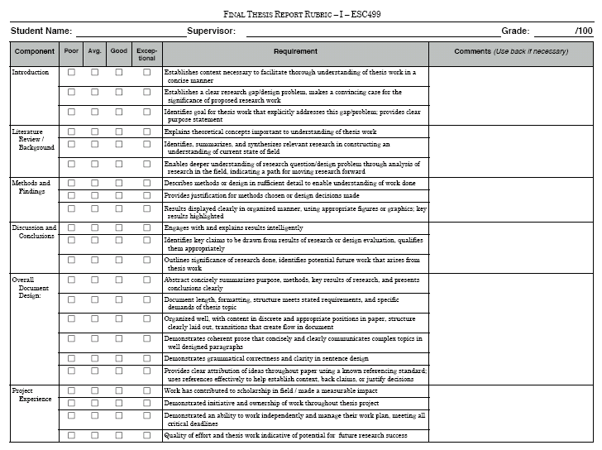
Mapping Indicators to Existing Evaluation (UofT)
1. Ability to define the problem
State the problem, its scope and importance Describe the previous work State the objective of the work
1. Ability to identify and credibly communicate engineering knowledge
Situate, in document or presentation, the solution or design in the world of existing engineering, taking into account social, environmental, economic and ethical consequences Recognize a credible argument (reading) Construct a credible argument in written or spoken form – to persuasively present evidence in support of a claim Organize written or spoken material– to structure overall elements so that their relationship to a main point and to one another is clear Create “flow” in document or presentation – flow is a logical progression of ideas, sentence to sentence and paragraph to paragraph

Slide 31
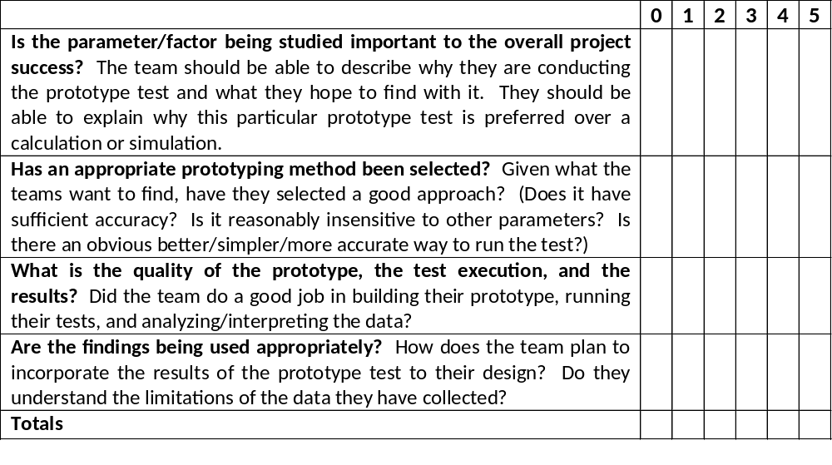
Old Evaluation Form (UBC)

Slide 32
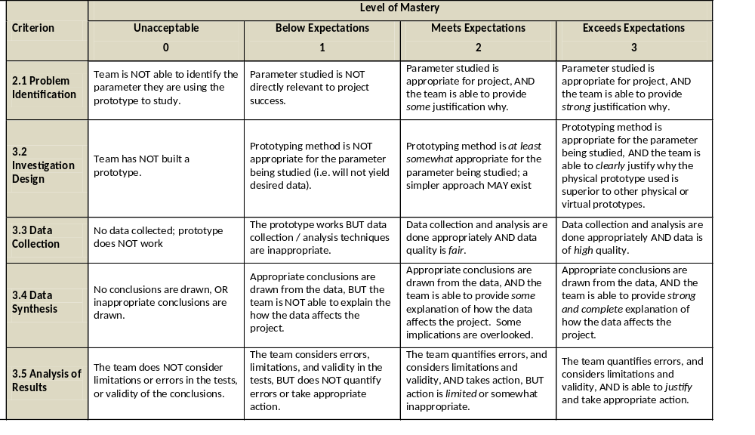
Evaluation Reformatted as Rubric (UBC)

Slide 33
4. Analyzing and interpreting the data
Timing of data collection and analysis
Analysis of the data
Data used to inform the improvement plan.

Slide 34
4. Analyzing and Interpreting the data
What to look for:
Timing of data collection and analysis is clear, and continuous (cyclic).
Analysis is high quality and addresses the data
Improvement plan aligns with the analysis and data
Improvement plan is implemented

Slide 35
5. Data-informed Curriculum Improvement
The process of “closing the loop”
Information collected, analyzed and used for curriculum improvement

Slide 36
5. Data-informed Curriculum Improvement
What to look for:
Integrity of the overall research method:
  Quality of the research questions
  Quality of the methodology
    Indicators
    Curriculum mapping
    Data collection process
  Valid, reliable data collected
  Analysis of the data is clear and well grounded
Results used to inform curriculum change

Slide 37
Disaggregating the data to get more information
Performance histogram
Fails
Below Expectation
Meets Expectation
Exceeds Expectation
Indicator #1
Indicator #2
Indicator #3
Investigation

Slide 38
Disaggregating the data to get more information
Performance histogram
First year
Middle year
Final year
Indicator #1
Indicator #2
Indicator #3
Investigation

Slide 39
Why not use grades to assess outcomes?
How well does the program prepare
students to solve open-ended
problems?
Student transcript
Electric Circuits I Electromagnetics I Signals and Systems I Electronics I Electrical Engineering Laboratory Engineering Communications Engineering Economics ... Electrical Design Capstone | 78 56 82 71 86 76 88 86
Are students prepared to continue
learning independently after
graduation?
Do students consider the social
and environmental implications of
their work?
Course grades usually aggregate
assessment of multiple objectives,
and are indirect evidence for
some expectations
What can students do with
knowledge (plug-and-chug vs.
evaluate)?

Slide 40
Rubrics
Dimensions (Indicator) | Scale (Level of Mastery)
 | Not demonstrated | Marginal | Meets expectations | Exceeds expectations
Indicator 1
Descriptor 1a
Descriptor 1b
Descriptor 1c
Descriptor 1d
Indicator 2
Descriptor 2a
Descriptor 2b
Descriptor 2c
Descriptor 2d
Indicator 3
Descriptor 3a
Descriptor 3b
Descriptor 3c
Descriptor 3d
Reduces variations between grades (increase reliability)
Describes clear expectations for both instructor and students (increase validity)

Slide 41
Histograms for Lifelong learning (Queens)
3.12-FY1 | Uses information effectively, ethically, and legally to accomplish a specific purpose, including clear attribution of Information sources.
3.12-FY2 | Identifies a specific learning need or knowledge gap.
3.12-FY5 | Identifies appropriate technical literature and other information sources to meet a need
3.12-FY6 | Critically evaluates the procured information for authority, currency, and objectivity.

Slide 42
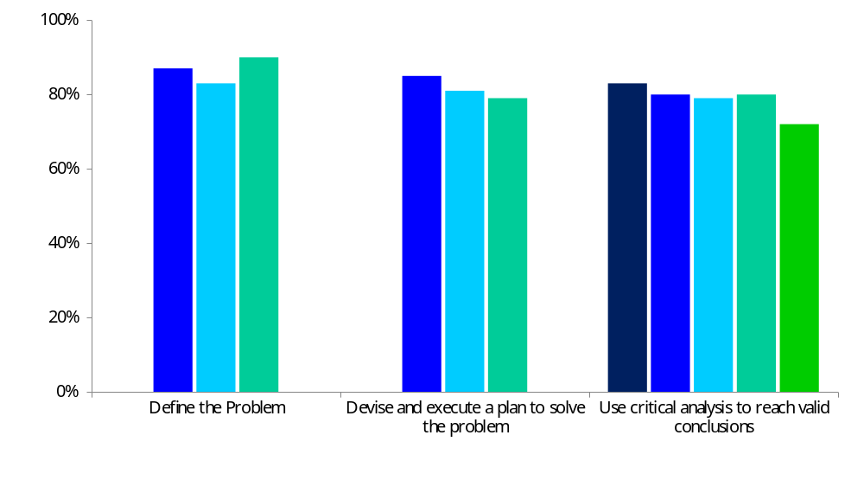
Histogram for Communication (UofT) several assessment points in ECE496
Percentage of students who meet or exceed performance expectations in indicators

Slide 43
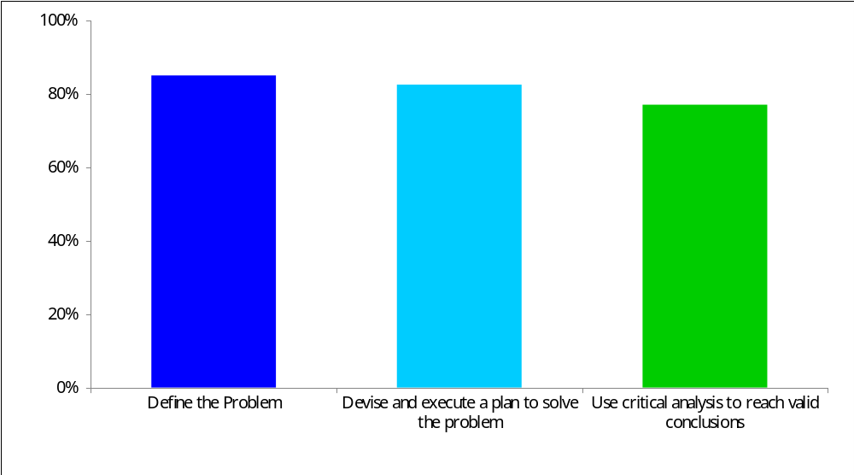
Histogram for Communication (UofT)
Percentage of students who meet or exceed performance expectations in indicators

Slide 44
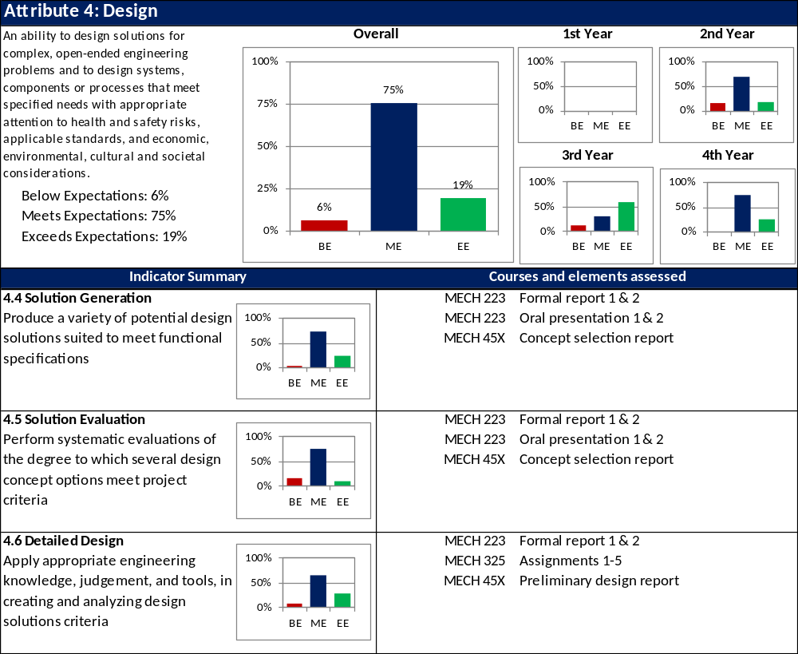
Histograms / Summary for Design (UBC)

