Slide 1

EGAD Graduate Attribute Assessment Workshop
Brian Frank Susan McCahan Peter Wolf
8:30-10:00 am June 8, 2011

Slide 2
Objectives of the Workshop
Be able to create a sustainable process for continual program improvement informed by data
Understand CEAB’s requirements for graduate attribute assessment.

Slide 3
Administrative issues
Slides and summary handout will be posted to EGAD website http://engineering.queensu.ca/egad/ under “RESOURCES”.
Other support and resources will described at the end.
NOTE: This is an active and collaborative workshop - feel free to ask questions or comment throughout.

Slide 4
Section 1: Providing Answers
What is GA?
Why GA?

Slide 5
What is EGAD?
Engineering Graduate Attribute Development Project
Composed of engineering educators and educational developers across Canada
Sponsored by deans of engineering
Working collaboratively with CEAB to ensure training and materials meet requirements

Slide 6
Graduate Attributes => Quality Assurance Standards
CEAB is requiring each program to create and apply a quality assurance process to improve the program
Like any QA process, it examines the outputs of a process – what is our ‘output’?
Process ~ Graduate Attribute assessment
New GA Process vs. traditional AU Count Process
  Pros: more flexibility for programs, much less prescriptive
  Cons: less guidance, more uncertainty. “What do they want to see?”

Slide 7
Graduate Attribute Assessment
In general, the term outcomes assessment is used to answer questions like:
  What can students do?
  How does their performance compare to our stated expectations?
It identifies gaps between
our perceptions of what we teach |  | actual knowledge, skills, and attitudes students develop program-wide.

Slide 8
Inputs and Outcomes
Inputs Student pre-university background Faculty education, professional status Ongoing faculty development Class sizes Content Campus resources Contact hours Laboratory equipment Support services | Outcomes Demonstrated abilities (cognitive, skills, attitudes)

Slide 9
Why GA?
A broader push for outcomes-based assessment:
  Accreditation bodies in most industrialized countries use outcomes-based program evaluation to demonstrate their students' capabilities.
  IEA’s Washington Accord: allows substantial equivalency of graduates from Australia, Canada, Hong Kong, Republic of Ireland, New Zealand, South Africa, United Kingdom, and United States, Japan, Singapore, Korea, and Chinese Taipei
  Ontario: University Undergraduate Degree Level Expectations (UUDLEs), Graduate Degree Level Expectations (GDLEs) will assessed in all programs, fortunately overlap graduate attributes

Slide 10
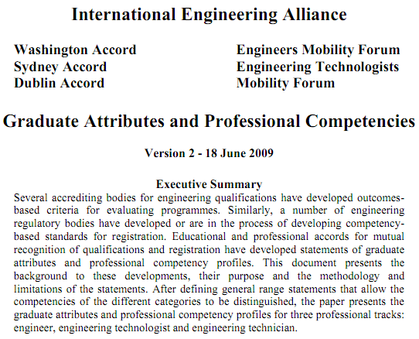
http://washingtonaccord.org

Slide 11
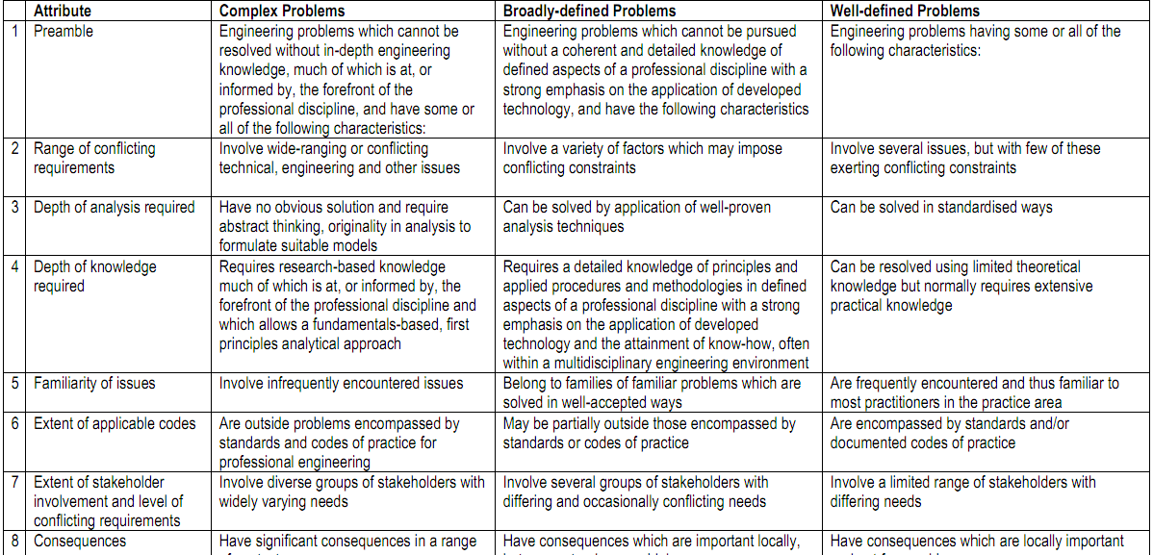
http://washingtonaccord.org

Slide 12
University Undergraduate Degree Level Expectations
    Depth and Breadth of Knowledge
    Knowledge of Methodologies
    Application of Knowledge
    Communication Skills
    Awareness of Limits of Knowledge
    Autonomy and Professional Capacity

Slide 13
Section 2: CEAB’s requirements for
Graduate Attribute Assessment

Slide 14
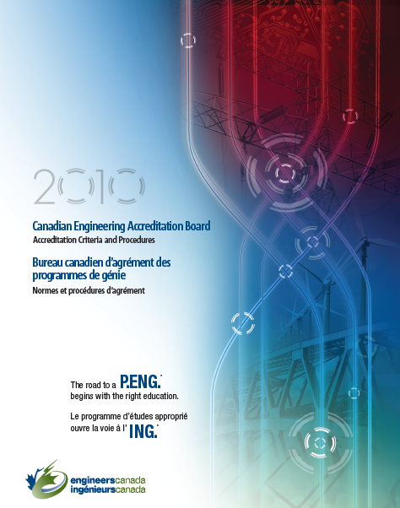
Perspective: Sec 3.1 of CEAB Procedures
“The institution must demonstrate that the graduates of a program possess the attributes under the following headings... There must be processes in place that demonstrate that program outcomes are being assessed in the context of these attributes, and that the results are applied to the further development of the program.”

Slide 15
12 Graduate Attributes
Knowledge base for engineering
Problem analysis
Investigation
Use of engineering tools
Design
Individual and team work
Communication skills
Professionalism
Impact on society and environment
Ethics and equity
Economics and project management
Lifelong learning

Slide 16
CEAB GA Assessment Instructions (2010)
Describe the processes that are being or are planned to be used. This must include:
a set of indicators that describe specific abilities expected of students to demonstrate each attribute
where attributes are developed and assessed within the program…
how the indicators were or will be assessed. This could be based on assessment tools that include, but are not limited to, reports, oral presentations, …
evaluation of the data collected including analysis of student performance relative to program expectations
discussion of how the results will be used to further develop the program
a description of the ongoing process used by the program to assess and develop the program as described in (a)-(e) above

Slide 17
Section 3: Creating a Process for
Graduate Attribute Assessment

Slide 18
Aside: Idealistic course development process
Create and
Execute a Plan
Overall
Improvement
Identify course
objectives and
content
Analyze and
evaluate data
Student input
Create specific
outcomes for each
class
Deliver, grade,
seek feedback
Identify appropriate
tools to assess
(reports, simulation,
tests,...)
Map to experiences
(lectures, projects,
labs, etc.)
Notes:
If we begin by talking about Outcomes-based assessment and curriculum review, it might be best to keep the language consistent by referring to class outcomes rather than objectives

Slide 19
Program-wide assessment process flow
Create a Program
Improvement Plan
Program & Course
Improvement
Defining Purpose
and Outcomes
Analysis and
Interpretation
Stakeholder input
Identifying and Collecting Data
Program
Mapping

Slide 20
Program
Course
Create a Program
Improvement Plan
Program &
Course
Improvement
Defining
program
purpose
and outcomes
Course
Learning
Objectives
Analysis and
Interpretation
Stakeholder
input
Course
assessment
Instructional
methods
Identifying and Collecting Data
Program
Mapping

Slide 21
Program-wide assessment process flow
Create a Program
Improvement Plan
Program & Course
Improvement
Defining Purpose
and Outcomes
Analysis and
Interpretation
Stakeholder input
Identifying and Collecting Data
Program
Mapping

Slide 22
Creating Program Purpose Statements
The purpose of a program is:
  to help students achieve outcomes and is therefore driven by their needs
  aligned with that of the Faculty which in turn is aligned with that of the institution
A program statement answers the following questions:
  What do we do?
  For whom?
  For what benefit?
  Ex. The purpose of the program is to provide a quality and broad engineering education, to conduct strong basic and applied research, and to serve the industry, the profession and the community at large through innovative solutions, dissemination of knowledge, and advancement of science and technology.

Slide 23
Program Purpose Tools
What do you want your program to be known for?
Required: CEAB graduate attributes (focus for this session) | Additional: Strategic plans Advisory boards Major employers of graduates Input from stakeholders Focus groups, surveys SWOT (strengths, weaknesses, opportunities, threats) analysis

Slide 24
Assessing Graduate Attributes
How to assess?
Knowledge base for engineering
Problem analysis
Investigation
Use of engineering tools
Design
Individual and team work
Communication skills
Professionalism
Impact on society and environment
Ethics and equity
Economics and project management
Lifelong learning

Slide 25
What are indicators?
Lifelong learning
An ability to identify and address their own educational needs in a changing
world in ways sufficient to maintain their competence and to allow them to
contribute to the advancement of knowledge
Can this be directly
measured?
Would multiple assessors
be consistent?
How meaningful would
the assessment be?
Probably not, so more specific measurable indicators are needed.
This allows the program to decide what is important

Slide 26
Indicators: examples
Lifelong learning
An ability to identify and address their own educational needs in a changing
world in ways sufficient to maintain their competence and to allow them to
contribute to the advancement of knowledge
Graduate
attribute
The student:
Critically evaluates information
for authority, currency, and
objectivity when referencing
literature.
Identify gap in knowledge and
develop a plan to address
Indicators
Describes the types of literature of
their field and how it is produced
Uses information ethically and legally
to accomplish a specific purpose
Notes:
I changed performance indicators to Indicators
BTW one of the critical indicators of a student’s ability to engage in Lifelong Learning is their ability to identify gaps in their knowledge and skill sets and create a plan to address them

Slide 27
Establishing Indicators
Level of expectation
(“describes”, “compares”, “applies”, “creates”, etc.)
Content area
Critically evaluates information for authority, currency, and
objectivity in reports.
A well-written indicator includes:
what students will do
the level of complexity at which they will do it
the conditions under which the learning will be demonstrated
context

Slide 28
Problematic Indicators
What does the author mean? Students can state
the laws? Plug numbers into equations? Apply laws
to solve conceptual problems? How do observe
learning?
Content area
Learns static physics principles including Newtonian laws
for linear motion

Slide 29
Descriptive Indicators
Knowledge base for engineering
Critically select* and apply* computational formula to solve novel problems
Engineering tools
Analyze* analog and digital circuits using a schematic capture and simulation tool to resolve a complex design problem
Demonstrate use* of a digital oscilloscope to characterize modulated signals in time and frequency domain in

Slide 30
Taxonomy
Useful to use a classification of learning objectives to structure expectations
Often divided into domains:
  Cognitive, psychomotor, affective
  “Knowing”, “doing”, “believing”
  “Factual”, “conceptual”, “procedural”, “metacognitive”

Slide 31
Taxonomy
Bloom’s (cognitive)
Bloom’s (affective)
Creating
(design, construct, generate ideas)
Receiving
(asks, describes, points to)
Evaluating/Synthesizing
(critique, judge, justify decision)
Responding
(answers, performs, practices)
Analyzing
(compare, organize, differentiate)
Valuing
(demonstrates belief in, sensitive to)
Applying
(use in new situation)
Organizing
(relates beliefs, balances)
Understanding
(explain, summarize, infer)
Internalizing
(acts, shows, practices)
Remembering/Knowing
(list, describe, name)
Anderson, L. W. and David R. Krathwohl, D. R., et al (Eds..) (2001) A Taxonomy for Learning, Teaching, and Assessing: A Revision of Bloom's Taxonomy of Educational Objectives

Slide 32
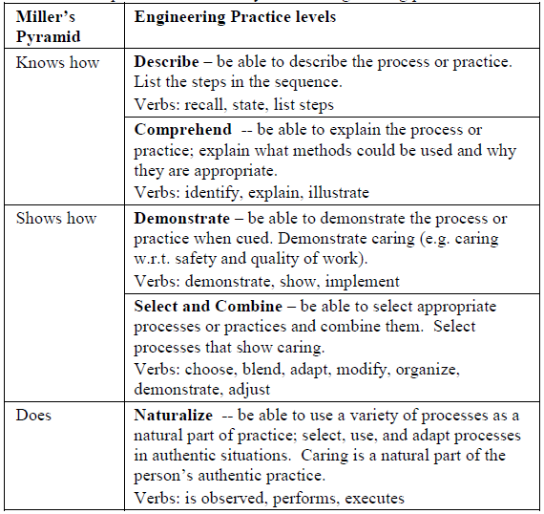
Taxonomy
Miller’s (McCahan, CEEA 2011)

Slide 33
Verbs for cognitive skills
Define
List
State
Recall
Identify
Recognize
Calculate
Label
Locate
Interpret
Compare
Contrast
Solve
Estimate
Explain
Classify
Modify
Integrate
Analyze
Hypothesize
Evaluate
Justify
Develop
Create
Extrapolate
Design
Critique
Higher order skills

Slide 34
Outcomes at Blooms’ Levels (Romkey, McCahan):
Creating
Argue the economic viability of the “green design” philosophy of product design.
Investigate recyclability/disposability issues relative to (a) metals, (b) glass, (c) polymers, and (d) composites.
Discuss the specific characteristics of the microstructure that render the stress-strain behaviour of a polymeric material as brittle, plastic, or elastic.
Utilize Poisson’s Ratio to calculate lateral strain given a longitudinal loading situation.
Explain Hooke’s Law in your own words and describe the conditions under which it is applicable.
Define the concepts of engineering stress and engineering strain.
Evaluating/Synthesizing
Analyzing
Applying
Understanding
Remembering/Knowing
34
Notes:
34
Objective/Outcomes decisions to be made

Slide 35
Task: Defining Indicators (10 min)
In groups of 2-4:
  Select a graduate attribute.
  Independently create some indicators for that attribute that reflect your program objectives
  Discuss indicators at your table.
    Are they measurable?
    Are they meaningful?
    Would the assessment of them be consistent from one rater to another?

Slide 36
Follow-up to identifying Indicators
Any points for discussion?

Slide 37
Additional Resources on Indicators
EC2000, ABET 2009
UK-SPEC, Engineering Subject Centre Guide
Engineers Australia
CDIO Syllabus
Foundation Coalition
UDLEs
IET criteria for ECE
Note: Indicators may also be known as:
  Assessment criteria
  Performance criteria
  Outcomes
  Competencies
  Objectives
Many linked at:
http://bit.ly/9OSODq
(case sensitive, no zeros)

Slide 38
Program-wide assessment process flow
Create a Program
Improvement Plan
Program & Course
Improvement
Defining Purpose
and Outcomes
Analysis and
Interpretation
Stakeholder input
Identifying and Collecting Data
Program
Mapping

Slide 39
Curriculum Mapping
Important to know where students (a) develop attributes and (b) are assessed
In a typical program the courses involved in assessing students are a small subset of courses. This might include a few courses from areas including:
  Engineering science
  Laboratory
  Complementary studies
  Project/experiential based

Slide 40
Where can we assess students?
Courses
Co-ops/internships
Co-curricular activities (competitive teams, service learning, etc.)
Exit or alumni surveys/interviews
...

Slide 41
Two approaches to mapping
Courses to attributes
“Let’s do a survey of our instructors, and determine where we are already developing attributes, and what we expect.”
Attributes to courses
“Let`s determine what we want the program to look like, then address how well our curriculum aligns.”
Can do this one way or both ways

Slide 42
Courses to Attributes
Assessment
Criteria
First year courses
Design
Physics
Calculus
Chemistry
etc.
First year
Design project course
Middle years
Assignment 1
used to assess:
Criteria 1
Criteria 2
Criteria 3
Assignment 2
used to assess:
Criteria 1
Criteria 4
Criteria 5
Team proposal
used to assess:
Criteria 1
Criteria 6
Criteria 7
etc.
Graduating year
Notes:
42

Slide 43
Courses to Attributes Example: First Year
Course | Grad Attributes Supported | Instructional Methods | Assessment tool(s)
APSC-100 (Engineering practice) | Communication Individual & Team Work Professionalism Lifelong Learning Problem analysis (open-ended) Investigation Ethics and equity | Design project Experimental project Model eliciting activity | Project reports Oral presentations Peer evaluations Supervisor evaluation All rubric-based
APSC-171 (Calculus I) | Knowledge Problem analysis (closed-ended) | Lecture, independent work | Targeted question on final exam

Slide 44
Attributes to Courses Example: Lifelong learning
Indicator | Developed | Assessed | Assessment tool(s)
Critically evaluates procured information for authority, currency, and objectivity | APSC-100 MECH-212 MECH-460 | MECH-460 | Project proposal report
 |  | MECH 490 | Oral exam
Describes professional and academic societies in the discipline and how new knowledge enters discipline. | APSC-100 MECH-270 MECH-333 MECH-490 | MECH-490 | Undergraduate thesis
Identifies resources and professional associations that address own ongoing professional development. | MECH-270 MECH-490 Co-op | MECH-490 | Pre-graduation interview
 |  | Co-op | Post co-op report

Slide 45
Other Mapping Tables (ABET)
Indicator | Developed | Assess. Method | Measured in: | Time | Coord. | Evaluation
Produces research information for the team | ME113, EM213, ME213, ME235, ME333, ME412 | Portfolios Peer Evaluations, Faculty Evaluations | ME 213 ME412 | ME 213 Even ME412 Odd | Even – Armaly Odd - Richards | Curriculum Committee
Demonstrates understanding of team roles when assigned | ME113, EM213, ME213, ME235, ME333, ME412 | Peer Evaluations, Faculty Evaluations | ME 213 ME412 | ME 213 Even ME412 Odd | Even – Armaly Odd - Richards | Curriculum Committee
Shares in the work of the team | ME113, EM213, ME213, ME235, ME333, ME412 | Peer Evaluations, Faculty Evaluations | ME 213 ME412 | ME 213 Even ME412 Odd | Even – Armaly Odd - Richards | Curriculum Committee
Demonstrates good listening skills | ME113, EM213, ME213, ME235, ME333, ME412 | Peer Evaluations, Faculty Evaluations | ME213 ME412 | ME 213 Even ME412 Odd | Even – Armaly Odd - Richards | Curriculum Committee

Slide 46
Curriculum Mapping Surveying
U Guelph developing Currickit: Curriculum Mapping Software
  Online survey, completed by each instructor, to describe whether an attribute is developed, assessed, or both
  Software collects data and reports on attributes in the program
CDIO: Introduced, Developed, or Utilized (ITU) survey in courses

Slide 47
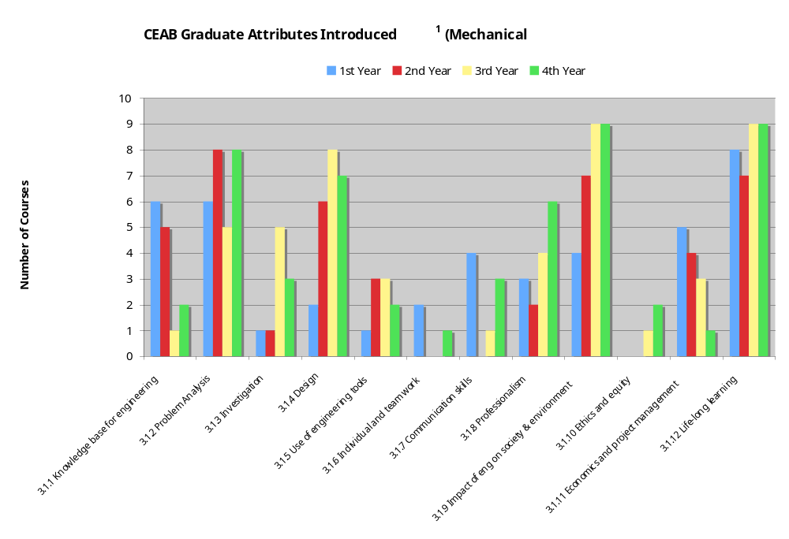
ITU Analysis (UCalgary)

Slide 48
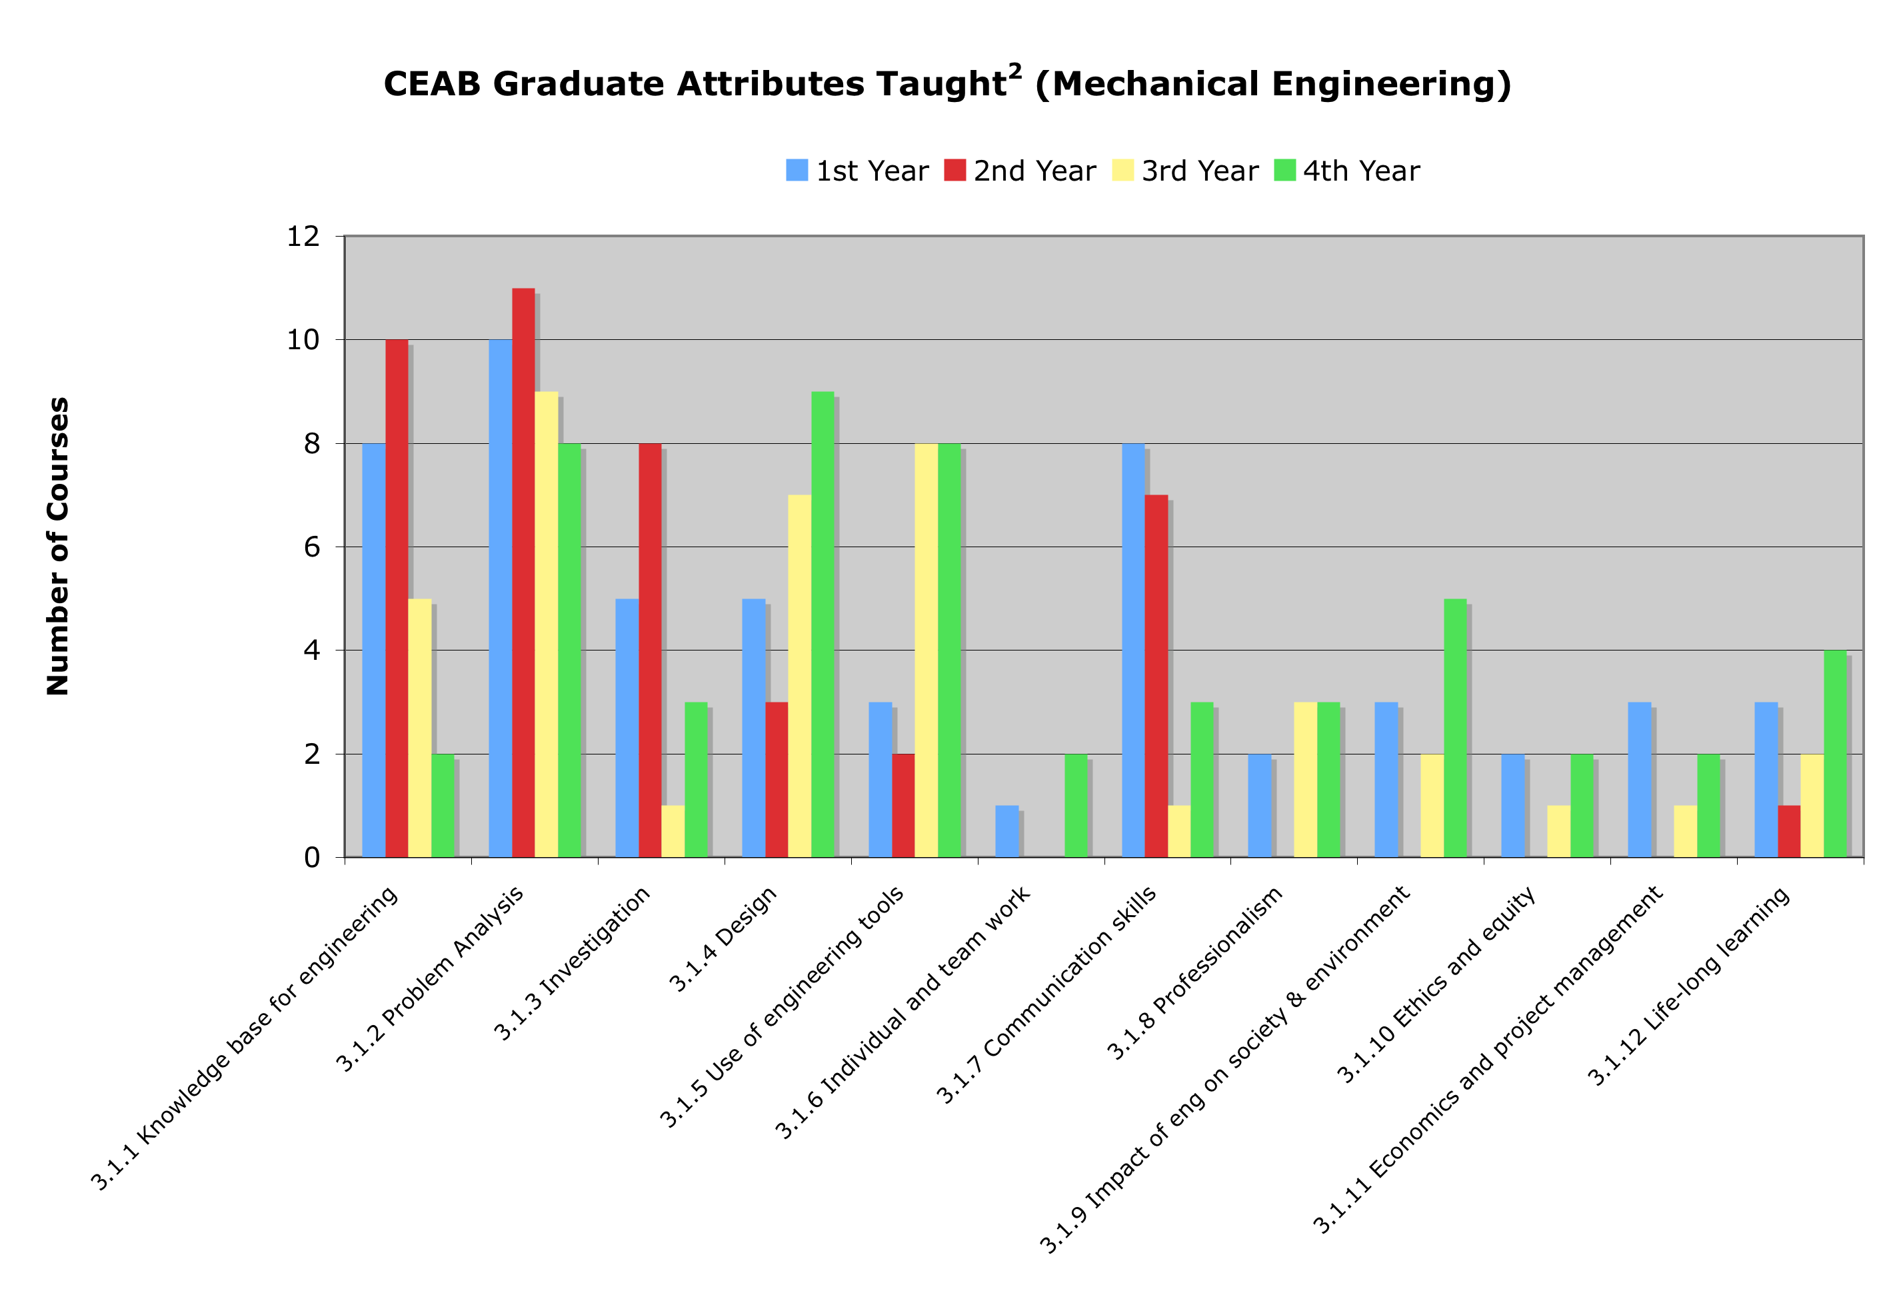
ITU Analysis (UCalgary)

Slide 49
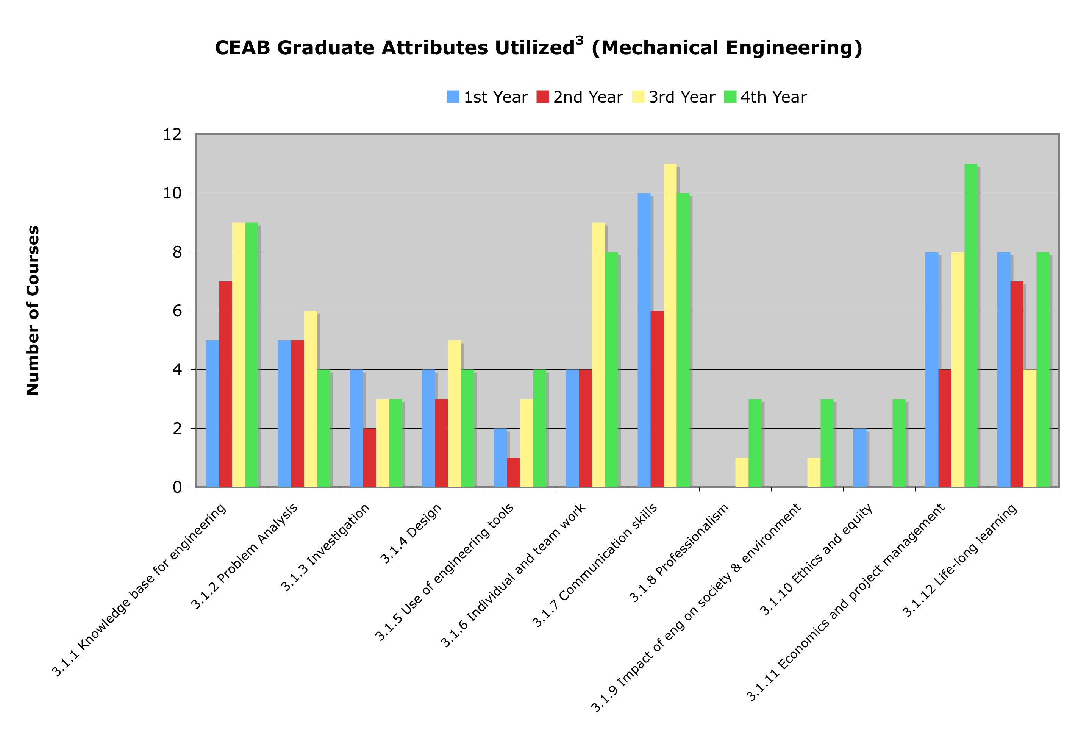
ITU Analysis (UCalgary)

Slide 50
Program-wide assessment process flow
Create a Program
Improvement Plan
Program & Course
Improvement
Defining Purpose
and Outcomes
Analysis and
Interpretation
Stakeholder input
Identifying and Collecting Data
Program
Mapping

Slide 51
Instructors: “We do assess outcomes – by grades”
How well does the program prepare
students to solve open-ended
problems?
Student transcript
Electric Circuits I Electromagnetics I Signals and Systems I Electronics I Electrical Engineering Laboratory Engineering Communications Engineering Economics ... Electrical Design Capstone | 78 56 82 71 86 76 88 86
Are students prepared to continue
learning independently after
graduation?
Do students consider the social
and environmental implications of
their work?
Course grades usually aggregate
assessment of multiple objectives,
and are indirect evidence for
some expectations
What can students do with
knowledge (plug-and-chug vs.
evaluate)?

Slide 52
Assessment Tools
How to measure learning against specific expectations?
Direct measures – directly observable or measurable assessments of student learning
  E.g. Student exams, reports, oral examinations, portfolios, concept inventories etc.
Indirect measures – opinion or self-reports of student learning or educational experiences
  E.g. grades, student surveys, faculty surveys, focus group data, graduation rates, reputation, etc.

Slide 53
Direct Measure Example: Assessment on exam
Exam based questions can be a non resource-intensive method of assessing for some outcomes
Appropriate for “knowledge”, “problem analysis”
Can be used as “easy wins” for some things

Slide 54
Indirect Measure Example: Student perspectives
Student surveys and focus groups give student perspective on development of attributes
What attributes do they think are being most/least developed in the program?
Duplication
Ideas on how to have students take some responsibility for demonstrating attributes

Slide 55
Assessment Tools
Local written exam
(e.g. question on final)
External examiner
(e.g. Reviewer on design projects)
Standardized written exam
(e.g. Force concept inventory)
Oral exam
(e.g. Design projects presentation)
Performance appraisal
(e.g. Lab skill assessment)
Oral interviews
Simulation
(e.g. Emergency simulation)
Surveys and questionnaires
Behavioural observation
(e.g. Team functioning)
Focus group
Portfolios
(student maintained material)
Archival records
(registrar's data, records, ...)

Slide 56
Examples of External Assessment Tools
Concept inventories (Force Concept Inventory, Statics concept inventory, Chemistry Concept Inventory, …)
Surveys of learning, engagement, etc.
  National Survey of Student Engagement (National data sharing, allowing internal benchmarking), E-NSSE
  Course Experience Questionnaire
  Collegiate Learning Assessment
  Approaches to Studying Inventory
  Academic motivation scale
  Engineering attitudes survey

Slide 57
Rubrics
Scales Dimensions | Not demonstrated | Marginal | Meets expectations | Exceeds expectations
Dimension 1: Information | Descriptor | Descriptor | Descriptor | Descriptor
Dimension 2: Design | Descriptor | Descriptor | Descriptor | Descriptor
Dimension 3: Communications | Descriptor | Descriptor | Descriptor | Descriptor
Reduces variations between grades
Describes clear expectations for both instructor and students

Slide 58
Targets and thresholds
Need to be able to explain what level of performance is expected of students
Useful to consider the minimum performance expectation (threshold) and what a student should be able to do (target)
Rubrics can be very useful

Slide 59
 | 1 (not demonstrated) | 2 (marginal) | 3 (meets expectations) | 4 (outstanding) | Mark
Gathers information from appropriate sources 3.04-FY4: Gathers info | No significant information used, not cited; blatant plagiarism. | Insufficient usage; improper citations. | Gathers and uses information from appropriate sources, including applicable standards, patents, regulations as appropriate, with proper citations | Uses information from multiple authoritative, objective, reliable sources; cited and formatted properly | /4
Plans and manages time and money 3.11-FY1: Manage time and money | No useful timeline or budget described; poorly managed project; safety issues | Poor timeline or budget; infrequent meetings; minor safety problems | Plans and efficiently manages time and money; team effectively used meetings; safety considerations are clear | Efficient, excellent project plan presented; detailed budget; potential risks foreseen and mitigated | /4
Describes design process 3.04-FY1: Uses process | No discussion of design process. | Generic design process described. | Describes design process used to design system, component, or process to solve open-ended complex problem. | Comprehensive design process described, with appropriate iterations and revisions based on project progress | /4
Incorporates social, environmental, and financial factors 3.09-FY4: Sustainability in decisions | No consideration of these factors. | Factors mentioned but no clear evidence of impact on decision making. | Incorporated appropriate social, environmental, and financial factors in decision making | Well-reasoned analysis of these factors, with risks mitigated where possible | /4
Demonstrates appropriate effort in implementation | Insufficient output | Sufficient implementation but some opportunities not taken, or feedback at proposal not incorporated in implementation | Appropriate effort, analysis, and/or construction demonstrated to implement product, process, or system | Outstanding implementation | /4
Compares design solution against objectives 3.04-FY7: Compares solution | No evaluation of design solution | Some factors missed in evaluating design solution | Compares the design solution against the project objectives and functional specifications, providing qualitative evaluation where appropriate | Comprehensive evaluation of design solution, with well-defended recommendations for future work or implementation | /4
Creates report following requirements | Poorly constructed report | Some organization problems, minor formatting problems, redundancy, spelling grammar/errors | Report achieves goal using formal tone, properly formatted, concisely written, appropriate use of figures, few spelling/grammar errors | Professional tone, convincing argument, authoritative, skillful transitions | /4
Overall Grade: |  |  |  |  | /28
threshold
target

Slide 60
Example: Knowledge assessment
Physics course instructors administering the Force Concept Inventory (FCI) before and after course in mechanics to assess conceptual understanding
Allows for benchmarking, which is difficult to do for most other indicators.
Notes:
60

Slide 61
Example: Knowledge assessment
Calculus instructor asked questions on exam that specifically targeted 3 indicators for “Knowledge”:
  “Create mathematical descriptions or expressions to model a real-world problem”
  “Select and describe appropriate tools to solve mathematical problems that arise from modeling a real-world problem”
  “Use solution to mathematical problems to inform the real-world problem that gave rise to it”
Notes:
61

Slide 62
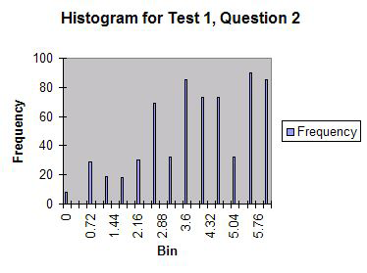
Indicator 1:
The student can create and/or select mathematical descriptions or expressions for simple real-world problems involving rates of change and processes of accumulation (overlaps problem analysis)
Context: calculating
Intersection of two
trajectories

Slide 63
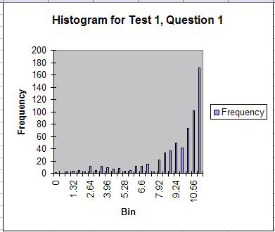
Indicator 2:
Students can select and describe appropriate tools to solve the mathematical problems that arise from this analysis
Context: differentiation
similar to high school
curriculum

Slide 64
Task: Assessment tools (5 min)
Take some assessment criteria developed by group previously:
  Determine three ways that they could be assessed (a list of assessment tools are on summary sheet), at least one done using a direct assessment tool
  If any are difficult to measure, consider whether the criteria should be modified

Slide 65
Principles of Measurement
Not required to measure every attribute every year. Could measure in years of accreditation cycle as follows:
  Design: Years 1,4
  Communications: Years 2,5
  Knowledge: Years 3,6...
No requirement to assess every student – appropriate sampling may be appropriate for some assessment measures
Assessment is for the program

Slide 66
Is this data useful?
Validity: how well an assessment measures what it is supposed to
  Direct measures vs. indirect
  Authentic assessment (emulating professional practice)
Reliability: the degree to which an instrument measures the same way each time it is used under the same condition with the same subjects;
  the repeatability of the measurement
  a measure is considered reliable if a person's score on the same test given twice is similar
  Estimated by test/retest, or internal consistency using multiple methods to assess same criteria

Slide 67
Data gathering and storage
Modern learning management systems are able to link outcomes to learning activities
E.g. Moodle, Blackboard, Desire2Learn
Reports, assignments, quizzes in the LMS can be linked to outcomes and simultaneously graded for course marks and assessment criteria

Slide 68
Program-wide assessment process flow
Create a Program
Improvement Plan
Program & Course
Improvement
Defining Purpose
and Outcomes
Analysis and
Interpretation
Stakeholder input
Collecting Data
Program
Mapping

Slide 69
Now that we have data… analyze and evaluate
Could do:
Longitudinal comparison of students
Histogram of results by level (did or did not meet expectations)
Triangulation: examination of correlation between results on multiple assessments of the same indicator (e.g. compare focus group data with exam results)
Rankings of indicators between courses
Comparison of indicators within courses
Qualitative data analysis

Slide 70
Example: Histograms for Lifelong learning
3.12-FY1 | Uses information effectively, ethically, and legally to accomplish a specific purpose, including clear attribution of Information sources.
3.12-FY2 | Identifies a specific learning need or knowledge gap.
3.12-FY5 | Identifies appropriate technical literature and other information sources to meet a need
3.12-FY6 | Critically evaluates the procured information for authority, currency, and objectivity.

Slide 71
Example: inter-rater reliability
Variation between graders

Slide 72
Program-wide assessment process flow
Create a Program
Improvement Plan
Program & Course
Improvement
Defining Purpose
and Outcomes
Analysis and
Interpretation
Stakeholder input
Collecting Data
Program
Mapping

Slide 73
Program Improvement Plan
Identify objectives for each course
Changes in existing courses
New courses/streams
  Integrative experience
  Design
Facilitated curriculum planning/strategic planning
New approaches
  service learning
  co-ops
  case-study
  problem-based learning
  model eliciting activities

Slide 74
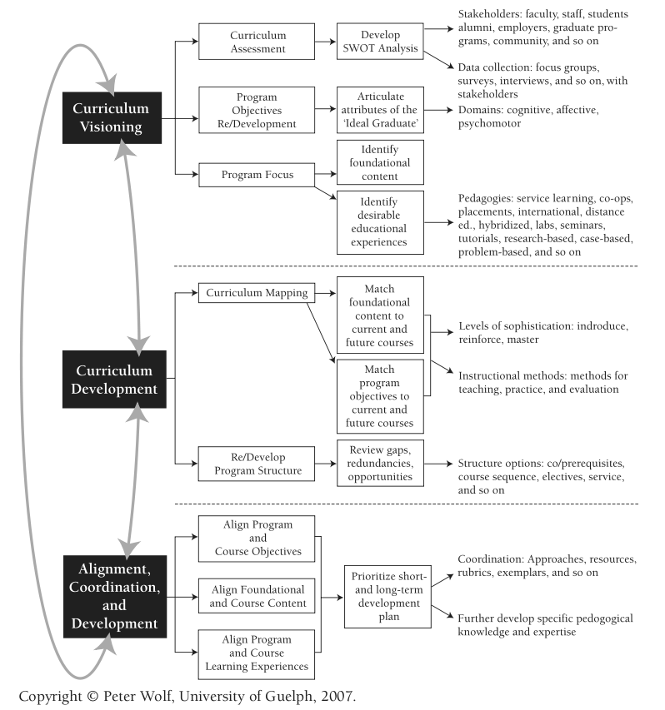
Example
From P. Wolf, New Directions for Teaching and Learning,
Volume 2007, Issue 112 (p 15-20). Used with permission.

Slide 75
Faculty buy-in
Faculty reaction skeptical to negative at first, but after 4-5 years value often perceived in outcomes assessment (US experience)
Often takes some time to understand rationale for criteria
Takes about 18 months to setup assessment process

Slide 76
General advice
Capitalize on what you're already doing: innovators, first adopters, experimenters
Dean/chair support can help encourage large scale curriculum development
Start from the question “what do we want to know to improve our program”, rather than “what does CEAB want us to do” – think of this as self-directed learning!
Don't generate reams of data that you don't know what to do with: create information, not data

Slide 77
EGAD Project
Developing workshops, case studies, guidelines, and recommended processes to share
Facilitating discussion between schools
Clearinghouse for resources developed across country
Offering support to programs as they prepare for accreditation
Working cooperatively with CEAB
Resources will be posted on website as they become available: http://engineering.queensu.ca/egad

Slide 78
Conclusion
Use and share ideas:
  Regional collaboration
  Publication of processes/plans at Canadian Engineering Education Association (CEEA) conferences
  EGAD
Training opportunities for curriculum chairs, etc.:
  ABET Institute for Development of Excellence in Assessment Leadership

